Slide 1


Course – TFC
Course Instructor
Dr. Umadevi V
Department of CSE, BMSCE
Webpage:https://sites.google.com/site/drvumadevi/

Slide 2
Unit-3
Context Free Grammars and Languages Parse Trees
Applications of Context Free Grammars, Ambiguity in Grammars and Languages, Eliminating Useless Symbols, Computing the Generating and Reachable Symbols, Eliminating Epsilon Productions, Eliminating Unit Productions, Chomsky Normal Form

Slide 3
Context-Free Grammars
A grammar is a set of rules for putting strings together and so corresponds to a language.
Why are such grammars called `context free'? Because all rules contain only one symbol on the left hand side and wherever we see that symbol while doing a derivation, we are free to replace it with the stuff on the right hand side. That is, the `context' in which a symbol on the left hand side of a rule occurs is unimportant, we can always use the rule to make the rewrite while doing a derivation.

Slide 4
General Introduction to Context Free Grammars (CFG)
In grammar, a rule that applies only in certain specified contexts.
A context-free grammar is one in which the rules apply regardless of context.
In the use of natural language, the truth value of a sentence can depend upon the context of its utterance

Slide 5
Why we should Study CFG’s Rough Slide
Program
Compiler
First phase
Understanding Keywords,
Variables names
Second Phase
Recognizing the structure
Of the language, Loop Structure,
Mathematical Expressions

Slide 6
General Introduction to Context Free Grammars (CFG)
Context-free grammars contain only rules that are not specified for particular contexts
Whereas context-sensitive grammars can have rules that can only be applied in certain circumstances.
In a context-free rule, the left-hand symbol can always be rewritten by the right-hand one regardless of the context in which it occurs.

Slide 7
CFG’s: Informal comments
A context-free grammar is a notation for describing languages.
It is more powerful than finite automata or RE’s, but still cannot define all possible languages.
Useful for nested structures, e.g., parentheses in programming languages

Slide 8
Example for CFG’s
CFG for L = { 0^{n}1^{n} | n > 1}
Productions (or Rules):
S -> 01
S -> 0S1
Basis: 01 is in the language.
Induction: if w is in the language, then so is 0w1.

Slide 9
Formal Definition of CFG
A Context-free grammar is a 4-tuple or quadruple
G=(V, T, P, S) where
V is a ﬁnite set called the Variables (non- terminals)
T is a ﬁnite set called the Terminals (V⋂T=∅ i.e., disjoint from V)
P is a ﬁnite set of Rules or Productions, where each rule maps a variable to a string V -> (V U T)*
S ∈ V is the Start symbol

Slide 10
Example: Formal CFG
Here is a formal CFG for {0^{n}1^{n} | n >=1}.
Terminals T = {0, 1}
Variables V = {S}
Start symbol S = S
Productions P =
S -> 01
S -> 0S1

Slide 11
Question
Here is a formal CFG for {0^{n}1^{n} | n >= 1}.
Terminals T = {0, 1}
Variables V = {S}
Start symbol S = S
Productions P =
S -> 01
S -> 0S1
Question:
If the language is L={0^{n}1^{n} | n >= 0}
Then what is the change we have to
do in Productions ?

Slide 12
Answer
Here is a formal CFG for {0^{n}1^{n} | n >= 0}
Terminals T = {0, 1, ε}
Variables V = {S}
Start symbol S = S
Productions P =
S -> ε
S -> 0S1

Slide 13
Questions
Obtain Context free grammar for the following languages
L={a^{n}b^{n}, n>=0}
L={a^{n+1}b^{n}, n>=0}
L={a^{n}b^{2n}, n>=0}

Slide 14
Rough Slide
Obtain Context free grammar for the following languages L={a^{n}b^{n}, n>=0}

Slide 15
Rough Slide
Obtain Context free grammar for the following languages L={a^{n+1}b^{n}, n>=0}

Slide 16
Rough Slide
Obtain Context free grammar for the following languages L={a^{n}b^{2n}, n>=0}

Slide 17
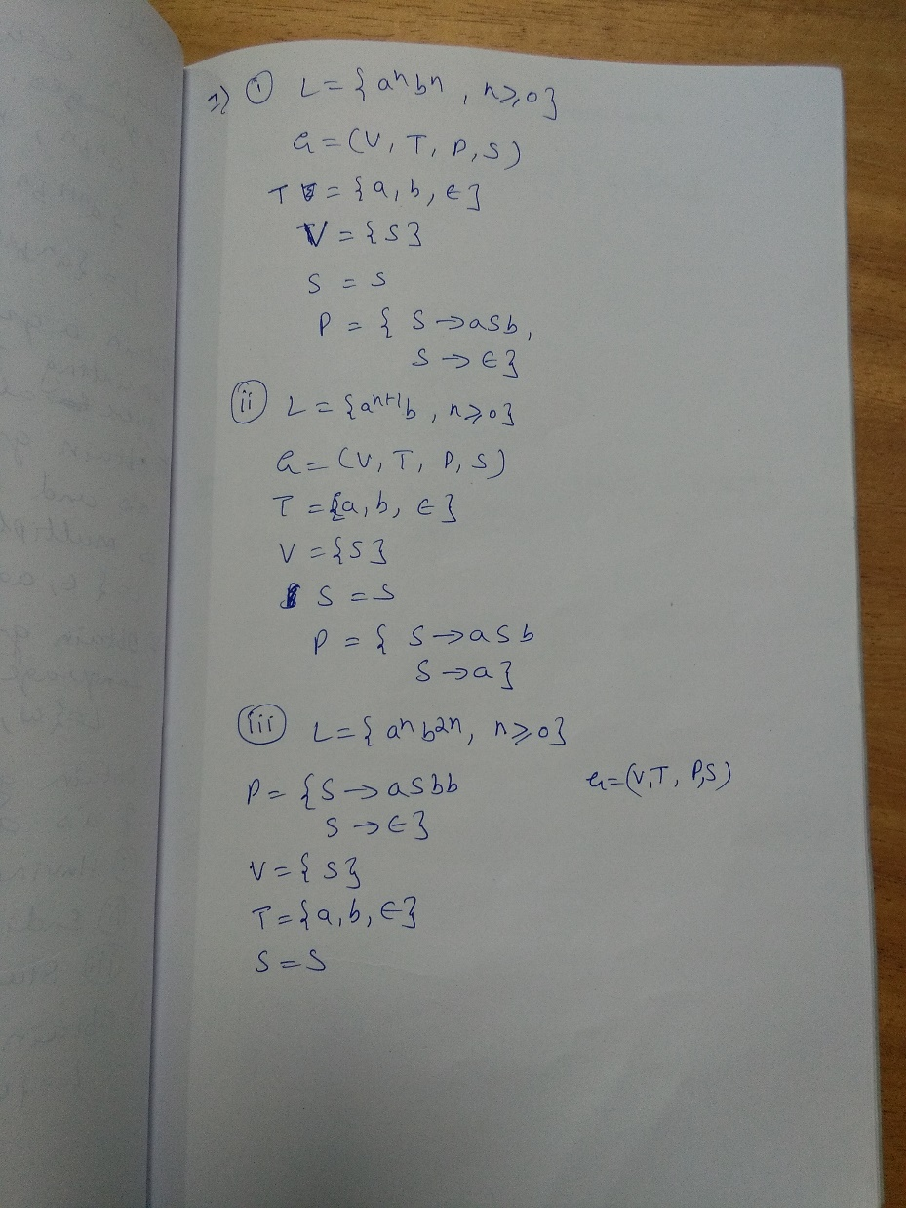

Slide 18
Questions
Obtain Context free grammar to generate strings consisting of multiples of three a’s
Obtain Context free grammar to accept the language L={w, |w| mod 3 > 0 , where w ∈ a*
Obtain Context free grammar to generate strings of a’s and b’s such that string length is multiple of 3

Slide 19
Rough Slide
Obtain Context free grammar to generate strings consisting of multiples of three a’s

Slide 20
Rough Slide
Obtain Context free grammar to accept the language
L={w, |w| mod 3 > 0 , where w ∈ a*

Slide 21
Rough Slide
Obtain Context free grammar to generate strings of a’s and b’s such that string length is multiple of 3

Slide 22
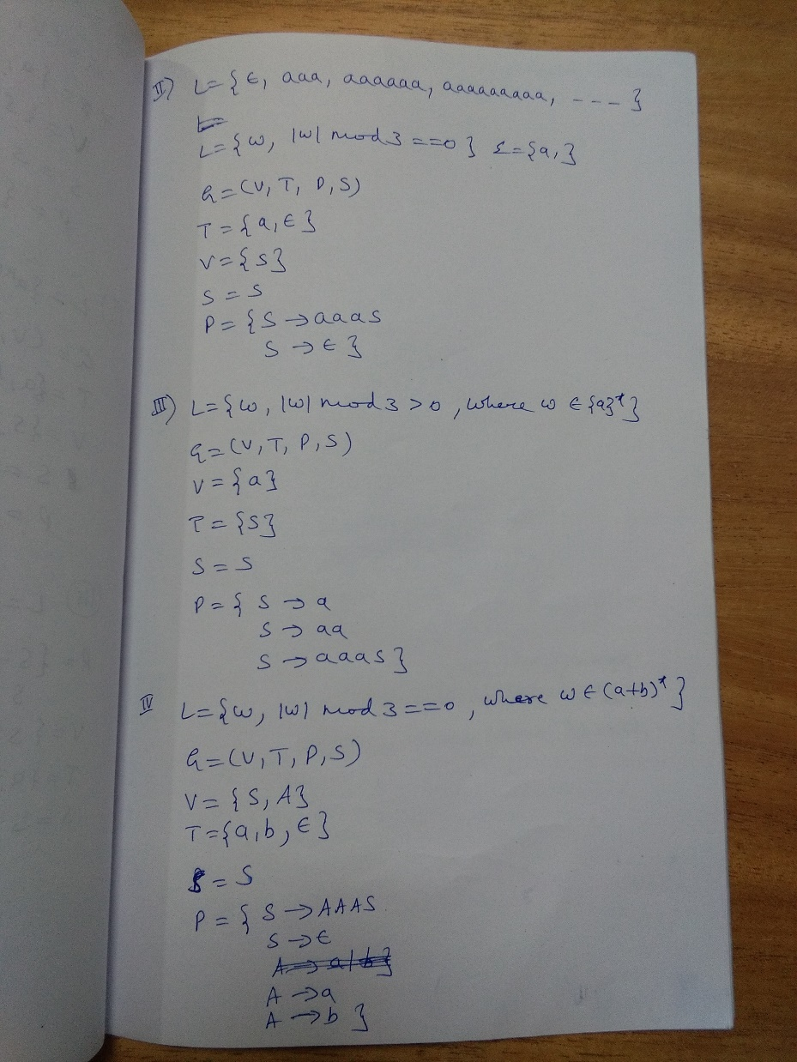

Slide 23
Questions
Obtain Context free grammar to generate strings of a’s and b’s
Having substring ‘ab’
Ending with ‘ab’
Starting with ‘ab’

Slide 24
Questions
Obtain Context free grammar for
L={ww^{R} , where w ∈ (a+b)*}

Slide 25
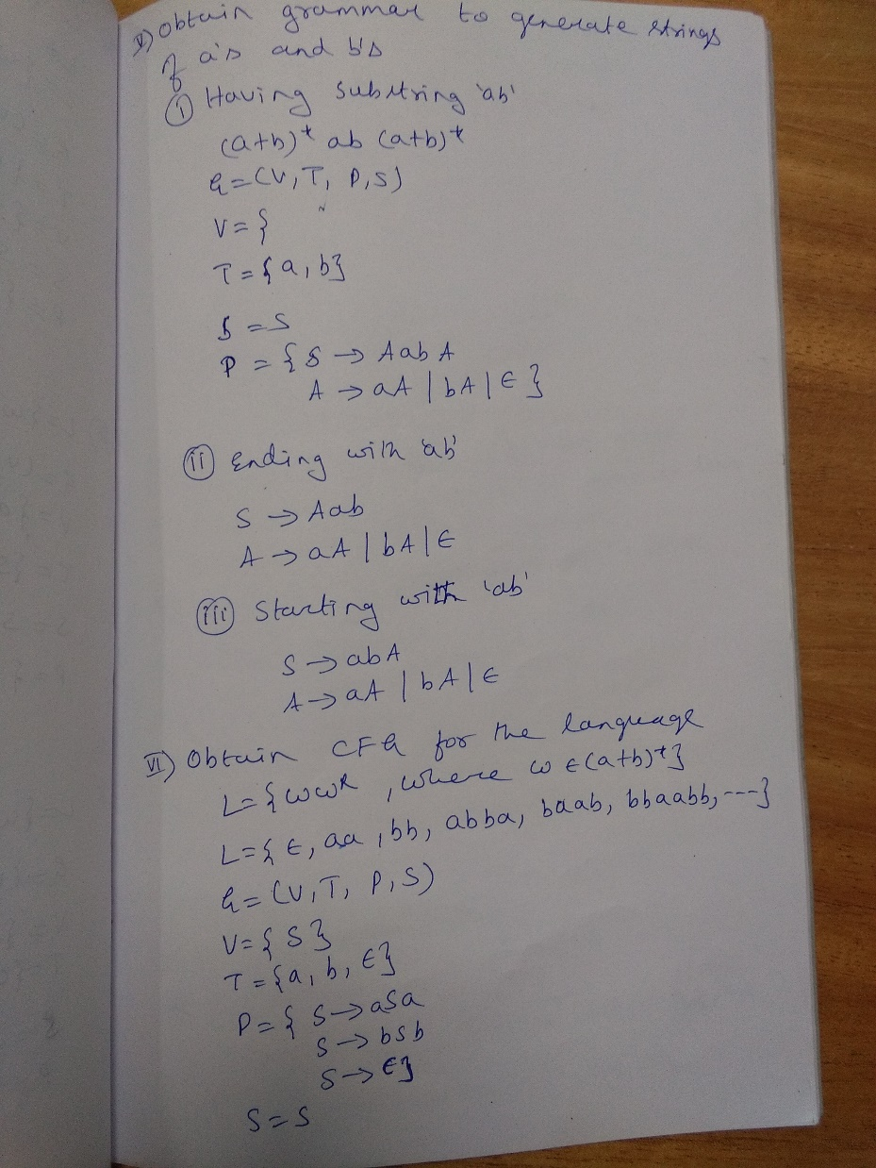

Slide 26
Questions
Obtain Context Free Grammar for the following Languages
i. L = { a^{n}b^{n-3} , n >= 3}
ii. L = {a^{n}b^{m} , n >= 0 , m > n }
iii. L = {a^{n+2}b^{m} , n >= 0 , m > n }
iv. L = {0^{i}1^{j} , i ≠ j , i >= 0 , j >=0 }

Slide 27
Rough Slide
Obtain Context Free Grammar for the following Languages
L = { a^{n}b^{n-3} , n >= 3}

Slide 28
Rough Slide
Obtain Context Free Grammar for the following Languages
L = {a^{n}b^{m} , n >= 0 , m > n }

Slide 29
Rough Slide
Obtain CFG for L = {a^{n+2}b^{m} , n >= 0 , m > n }

Slide 30
Rough Slide
Obtain CFG for L = {0^{i}1^{j} , i ≠ j , i >= 0 , j >=0 }

Slide 31
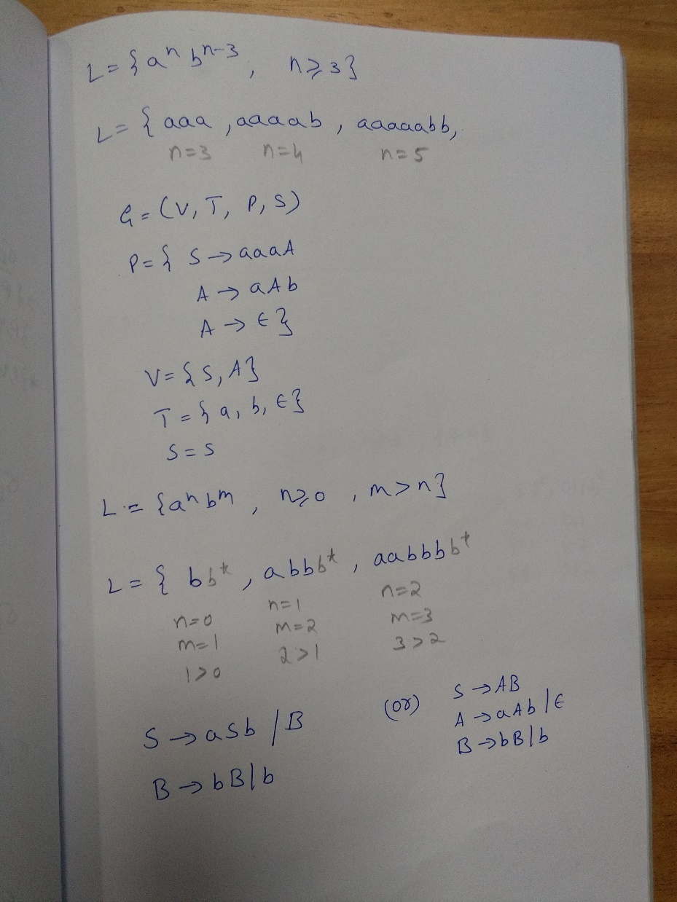

Slide 32
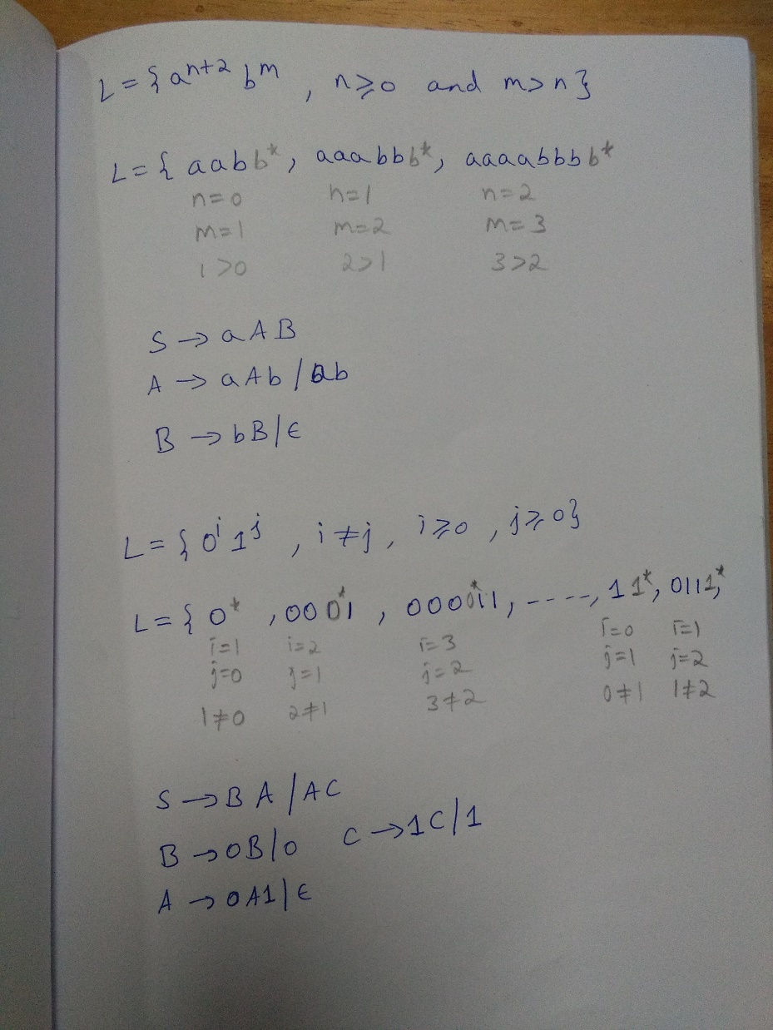

Slide 33
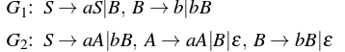
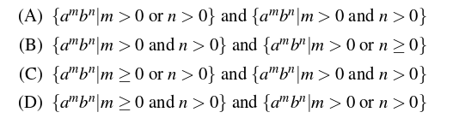
GATE Exam Question
Consider the following context-free grammars:
Which one of the following pairs of languages is generated by G1 and G2, respectively

Slide 34
GATE Exam Question
Consider the following context-free grammars:
Which one of the following pairs of languages is generated by G1 and G2, respectively
Answer: (D) Explanation: In G1, there will be atleast 1 b becase S-> B and B->b. But no. of A’s can be 0 as well and no. of A and B are independent.
In G2, either we can take S->aA or S->bB. So it must have atleast 1 a or 1 b.
So option D is correct.

Slide 35
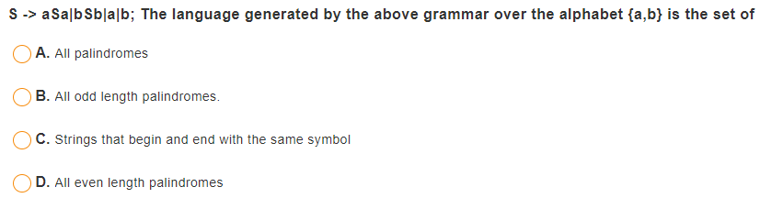
Question
Notes:
S-> aSa|bSb|a|b , the language generated by this grammar aver alphabet {a,b} is the set of
a. All Palindroms b. All odd length palindromes c. Strings that begin and end with same symbol d. All even length palindromes

Slide 36
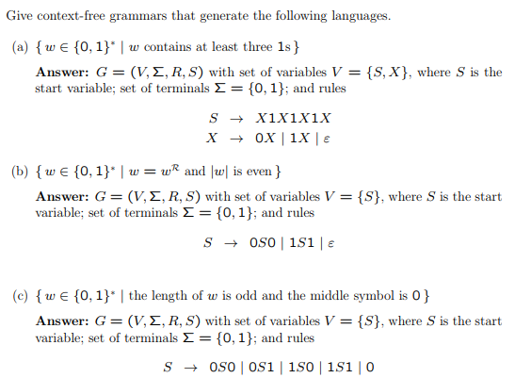
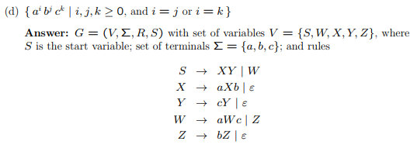
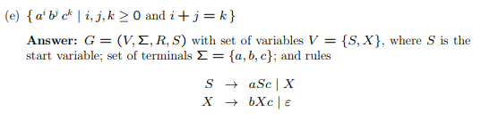

Slide 37
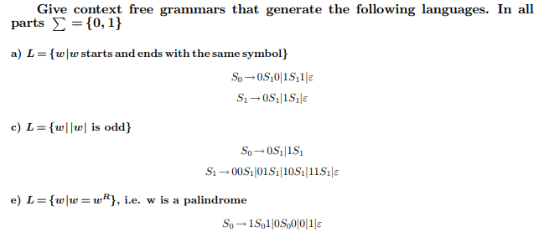

Slide 38
Questions
Obtain Context Free Grammar for the following Languages
i. L = { a^{n}b^{m}c^{k} , n+2m == k , n >= 0 , m >=0 }
ii. L = { a^{i}b^{j}c^{k} , i == j+k , n >= 0 , m >= 0 }
iii. L = { w ,n_{a}(w) == n_{b}(w)+1 , Σ = {a,b}}
iv. L = { w ,n_{a}(w) > n_{b}(w) , Σ = {a,b}}

Slide 39
Rough Slide
Obtain CFG for
L = { a^{n}b^{m}c^{k} , n+2m == k , n >= 0 , m >=0 }

Slide 40
Rough Slide
Obtain CFG for
L = { a^{i}b^{j}c^{k} , i == j+k , n >= 0 , m >= 0 }

Slide 41
Rough Slide
Obtain CFG for
L = { w ,n_{a}(w) == n_{b}(w)+1 , Σ = {a,b}}

Slide 42
Rough Slide
Obtain CFG for
L = { w ,n_{a}(w) > n_{b}(w) , Σ = {a,b}}

Slide 43
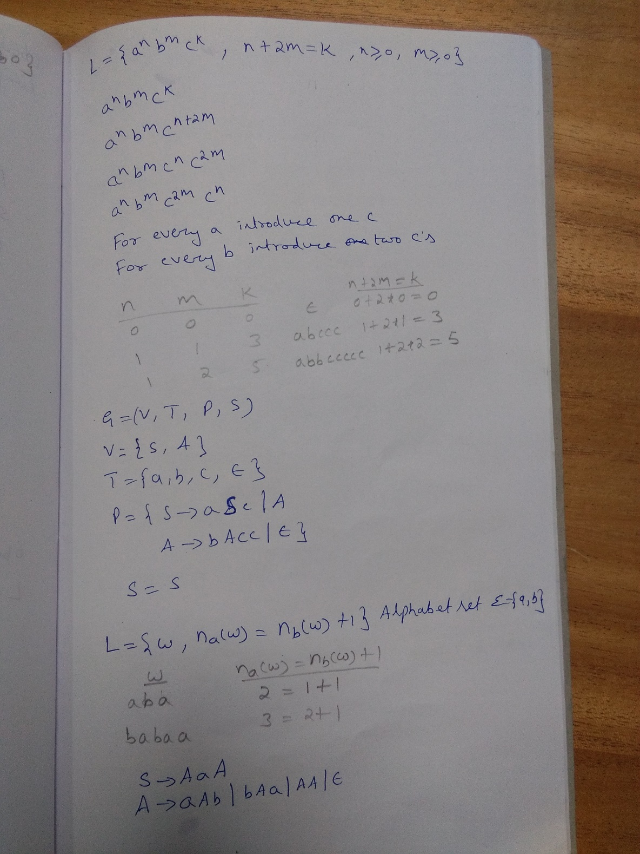

Slide 44
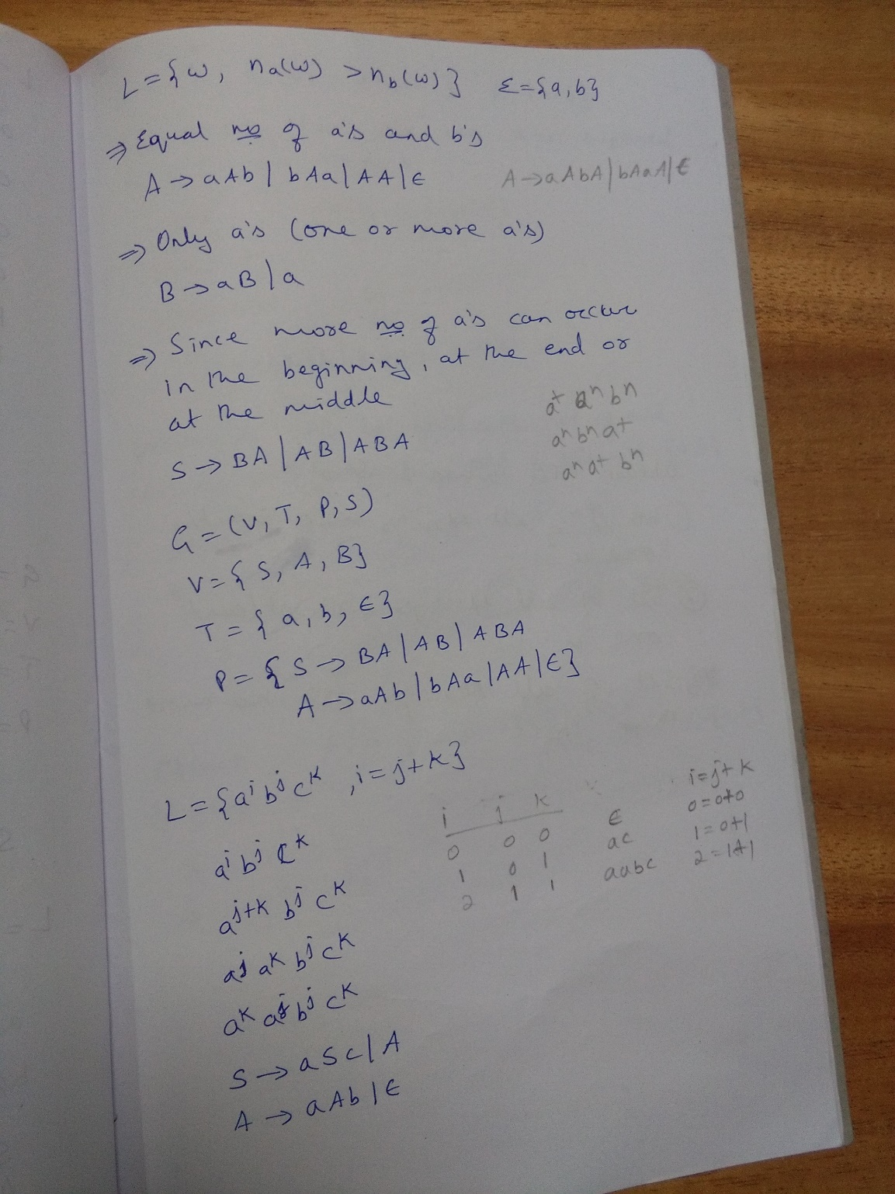

Slide 45
Question
Consider,
L₁ = {a^{n}b^{m} , n >= 0 , m > n } and L₂ = {0^{n}1^{2n} , n >= 0 }
Obtain CFG for
i. L = L₁L₂
ii. L = L₁ U L₂

Slide 46
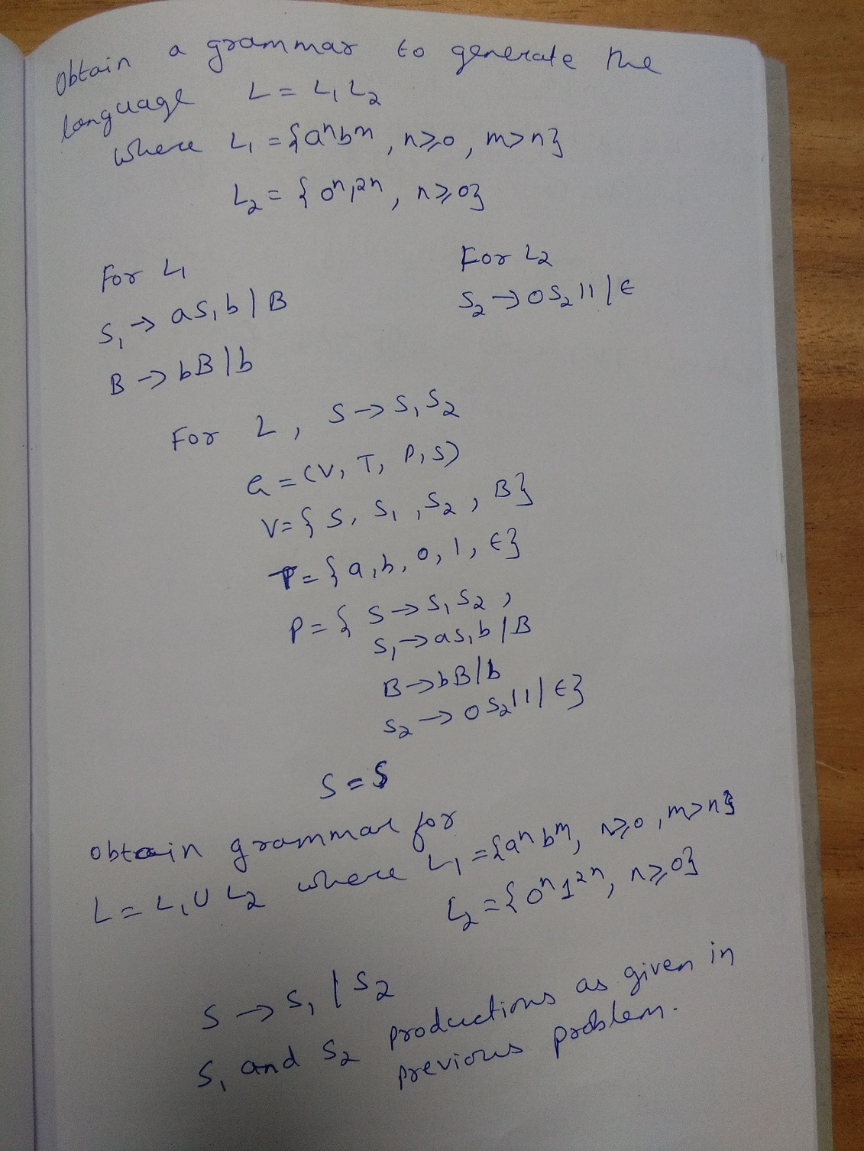

Slide 47
Questions
Obtain CFG when Σ = {a,b}
i. Set of all strings with exactly one ‘a’
ii. Set of all strings with at least one ‘a’
iii. Set of all strings with no more than three a’s

Slide 48
Rough Slide
Obtain CFG when Σ = {a,b}
iii. Set of all strings with no more than three a’s
There can be no a’s at all
There can be only one ‘a’
There can be only two a’s
There can be only three a’s

Slide 49
Question
Obtain CFG to generate properly nested parenthesis involving three kinds of parenthesis ( ) , { } , [ ]

Slide 50
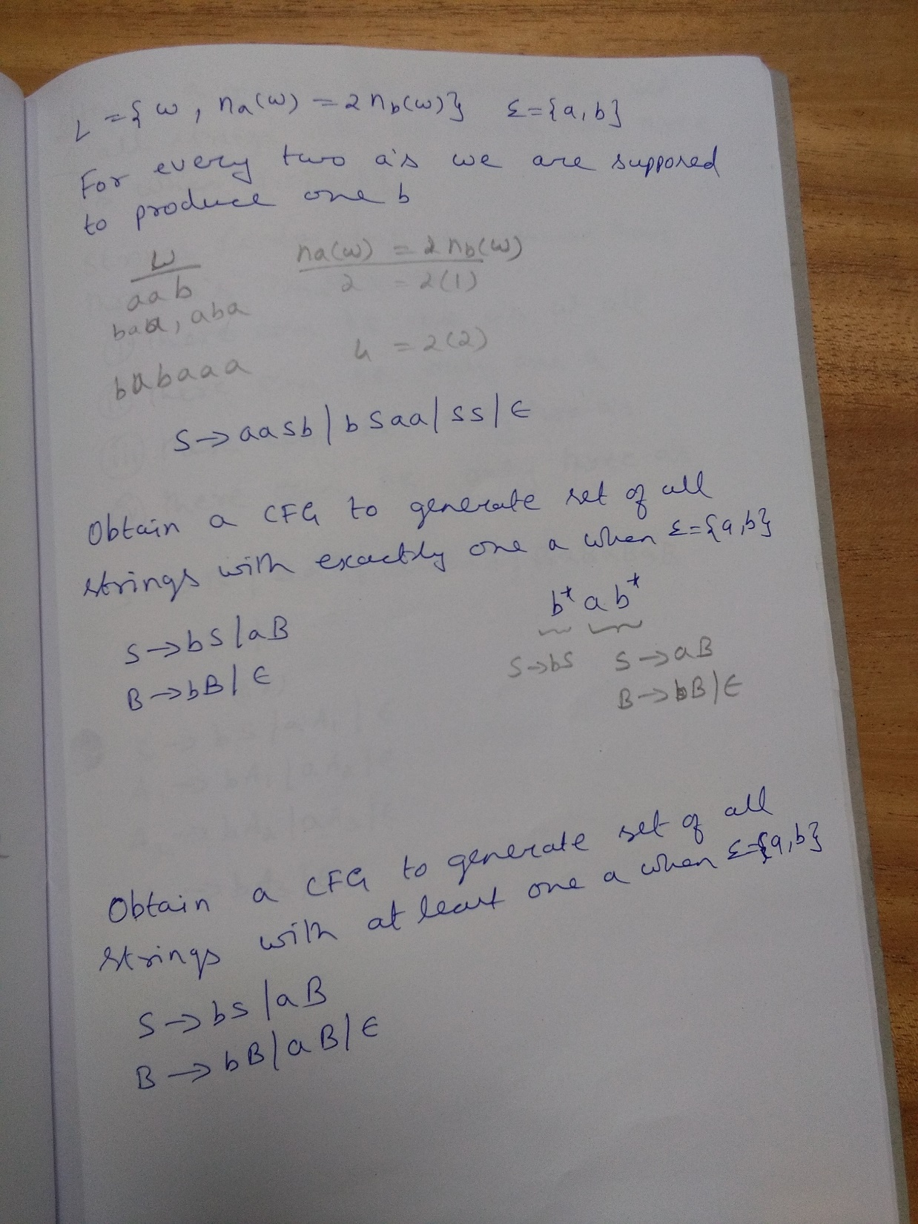

Slide 51
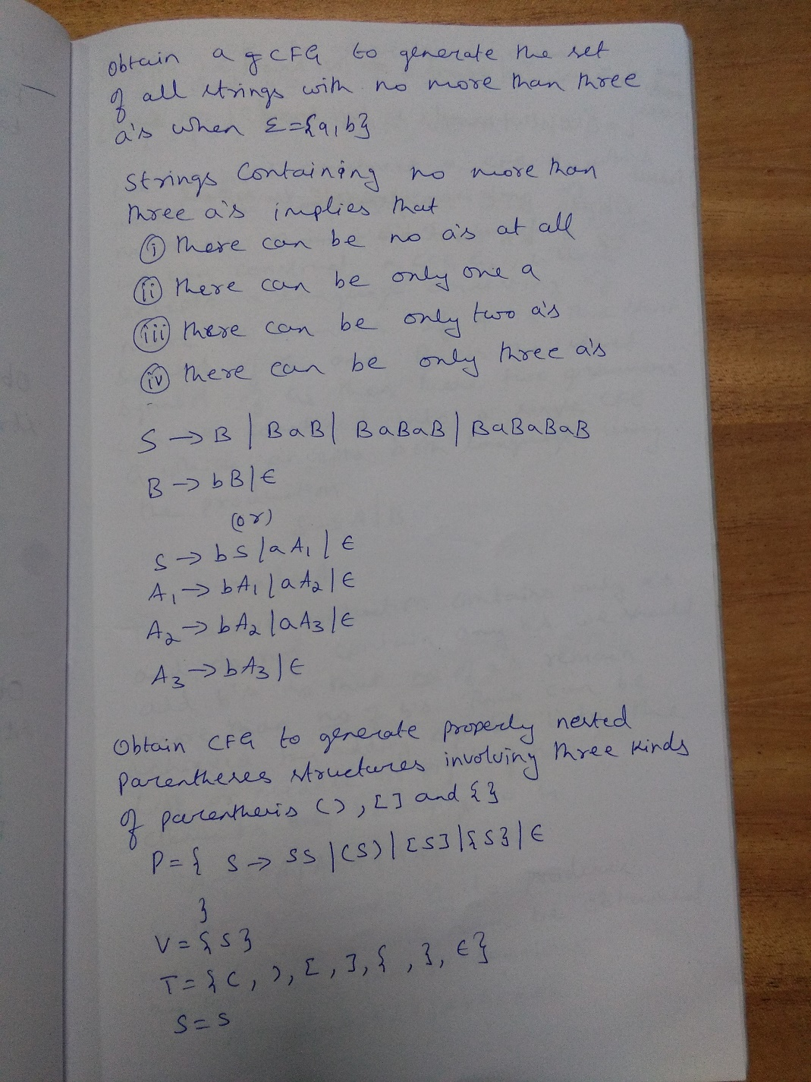

Slide 52
Question
Obtain CFG to generate unequal number of a’s and b’s over the alphabet set Σ = {a, b}

Slide 53
Rough slide
Obtain CFG to generate unequal number of a’s and b’s over the alphabet set Σ = {a, b}
Case 1: Construct grammar G₁ to generate more number of a’s than b’s
Case 2: Construct grammar G₂ to generate more number of b’s than a’s

Slide 54
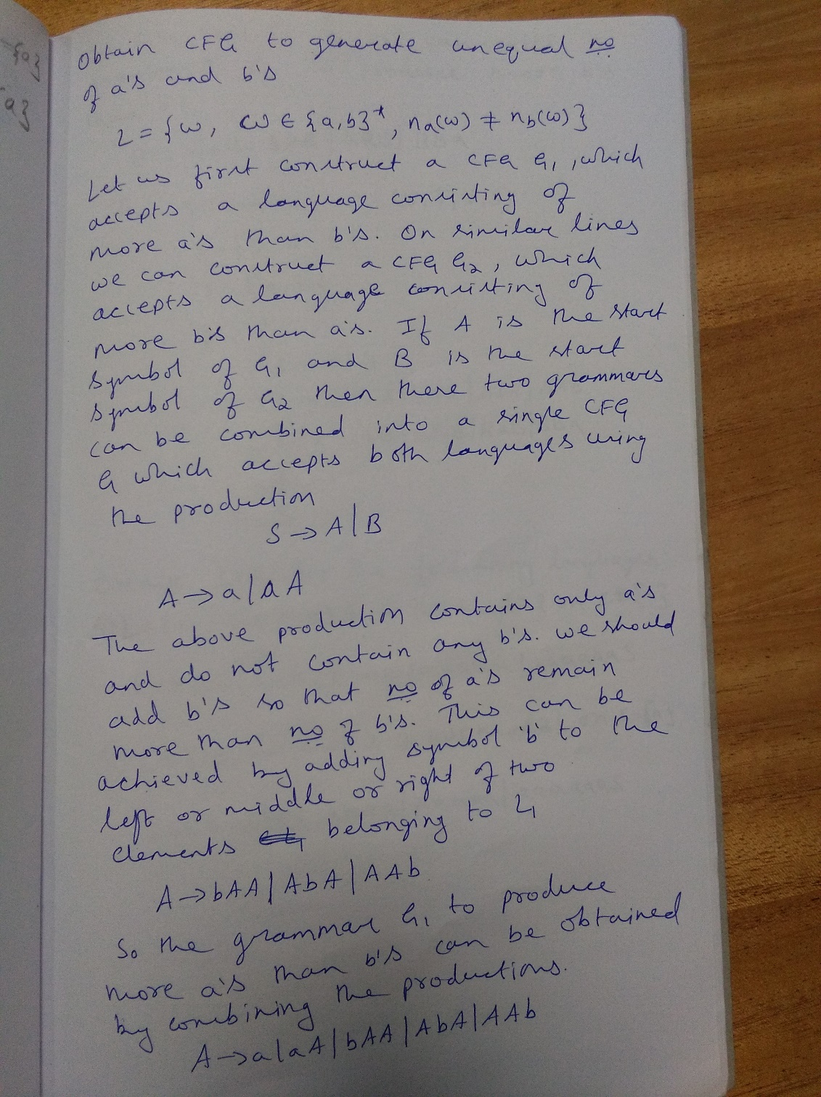

Slide 55
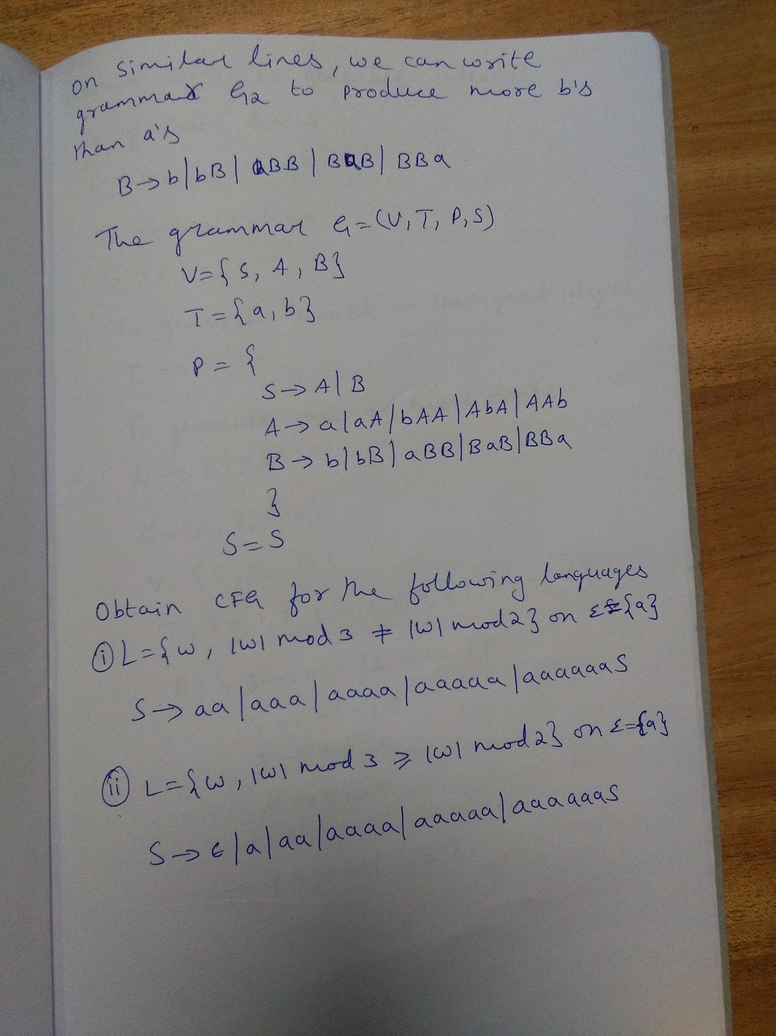

Slide 56
Question

Slide 57
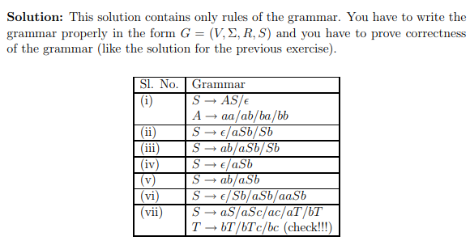
Solution

Slide 58
Question
The context free grammar S → SS | 0S1 | 1S0 | ɛ generates
a. Equal number of 0’s and 1’s
b. Unequal number of 0’s and 1’s
c. Number of 0’s followed by any number of 1’s
d. None of the mentioned

Slide 59
Question
Obtain CFG to generate Integers.

Slide 60
Rough Slide
Obtain CFG to generate Integers.

Slide 61
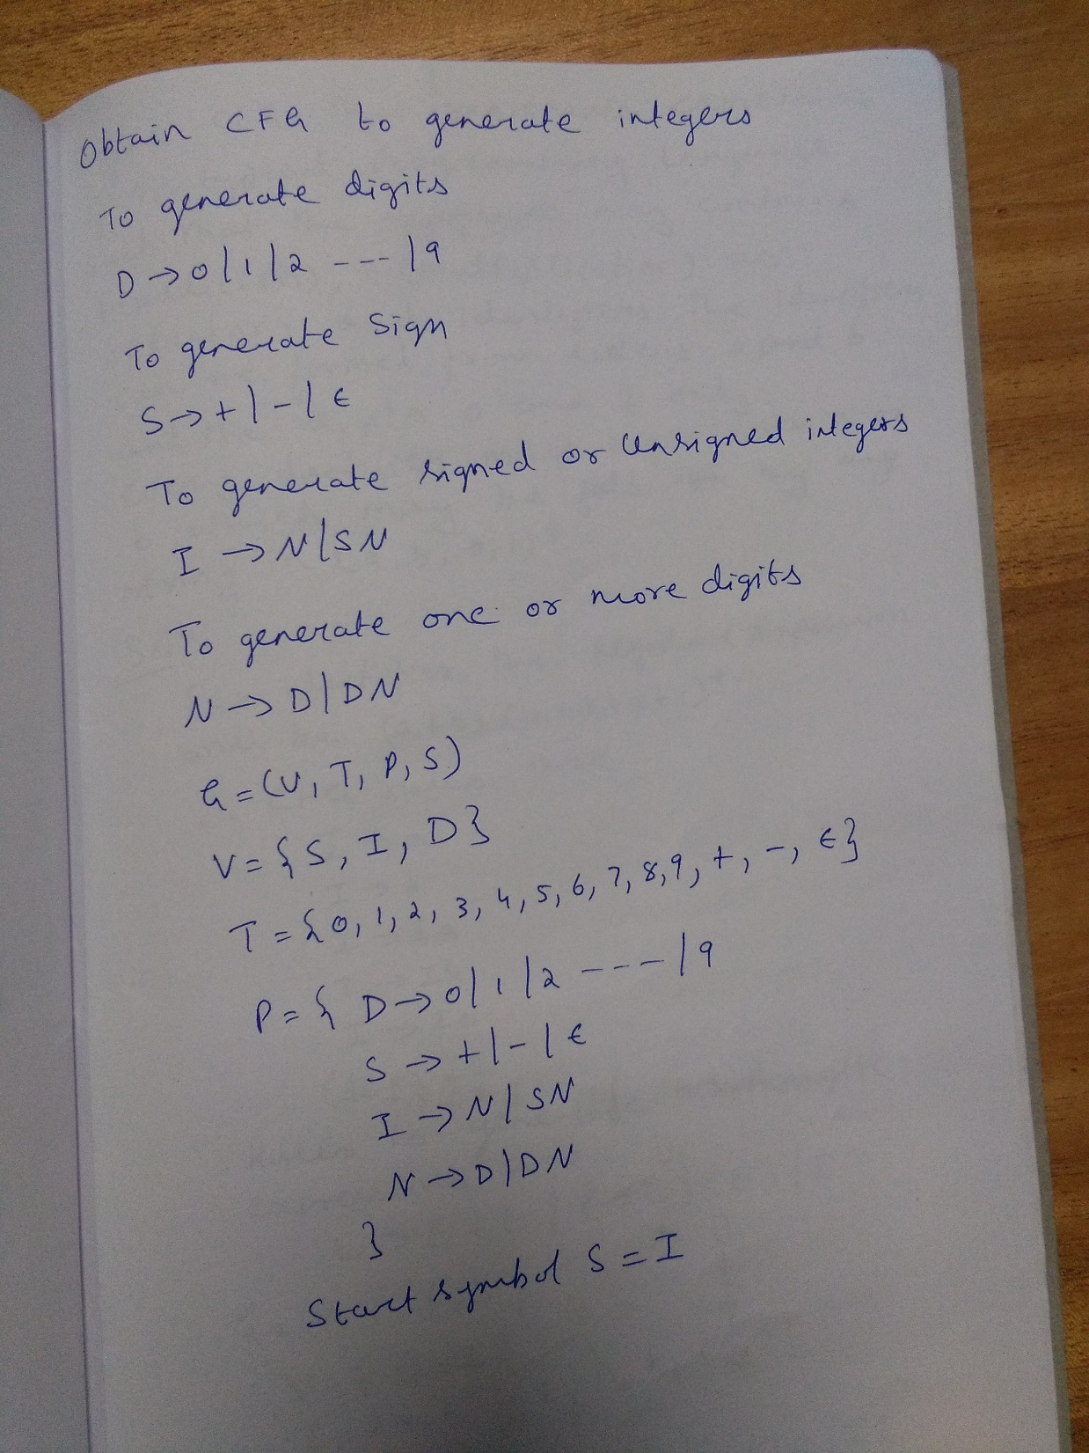

Slide 62
Question
Define CFG that represents expressions in a typical programming language. Such that the expressions may contain +(addition) , *(multiplication) as operators and identifiers. Expressions may also be properly nested parenthesises with only parenthesis allowed are ( , ). The identifiers can be formed from letters ‘a’ & ‘b’ and digits 0 & 1. Every identifier must begin with ‘a’ or ‘b’ which can be followed by any string in (a, b, 0, 1)*

Slide 63
Rough Slide
Define CFG that represents expressions in a typical programming language. Such that the expressions may contain +(addition) , *(multiplication) as operators and identifiers. Expressions may also be properly nested parenthesises with only parenthesis allowed are ( , ). The identifiers can be formed from letters ‘a’ & ‘b’ and digits 0 & 1. Every identifier must begin with ‘a’ or ‘b’ which can be followed by any string in (a, b, 0, 1)*

Slide 64
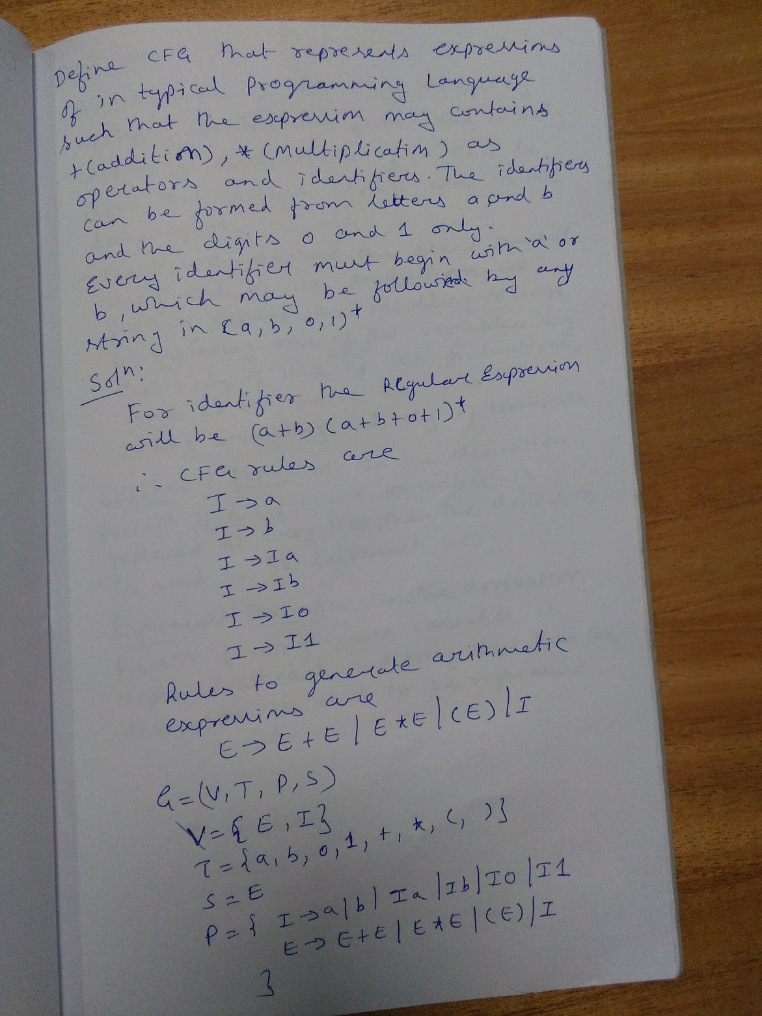

Slide 65
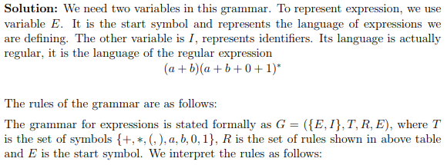
Solution

Slide 66
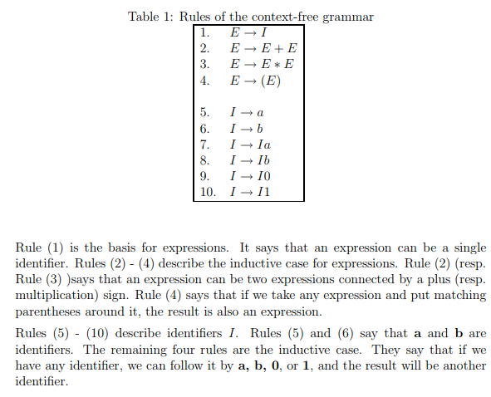
Solution

Slide 67
Unit-3
Derivations: Leftmost and Rightmost derivations
Derivation Tree or Parse Tree

Slide 68
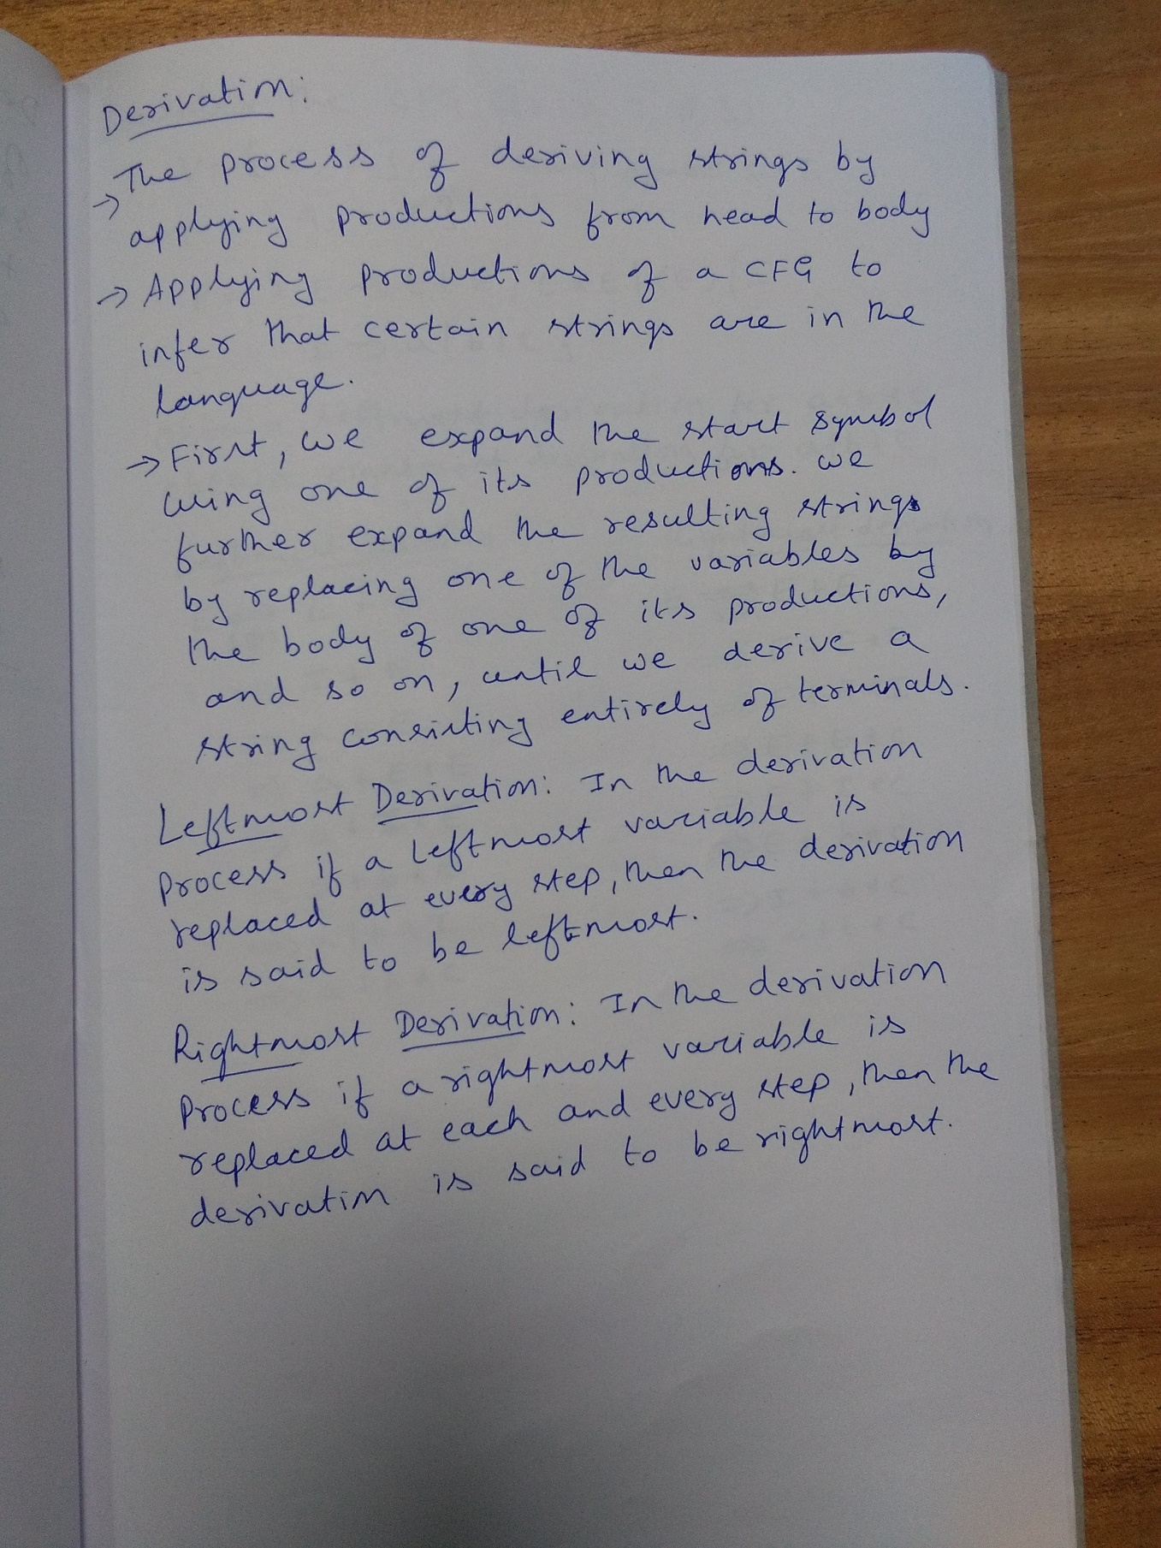

Slide 69
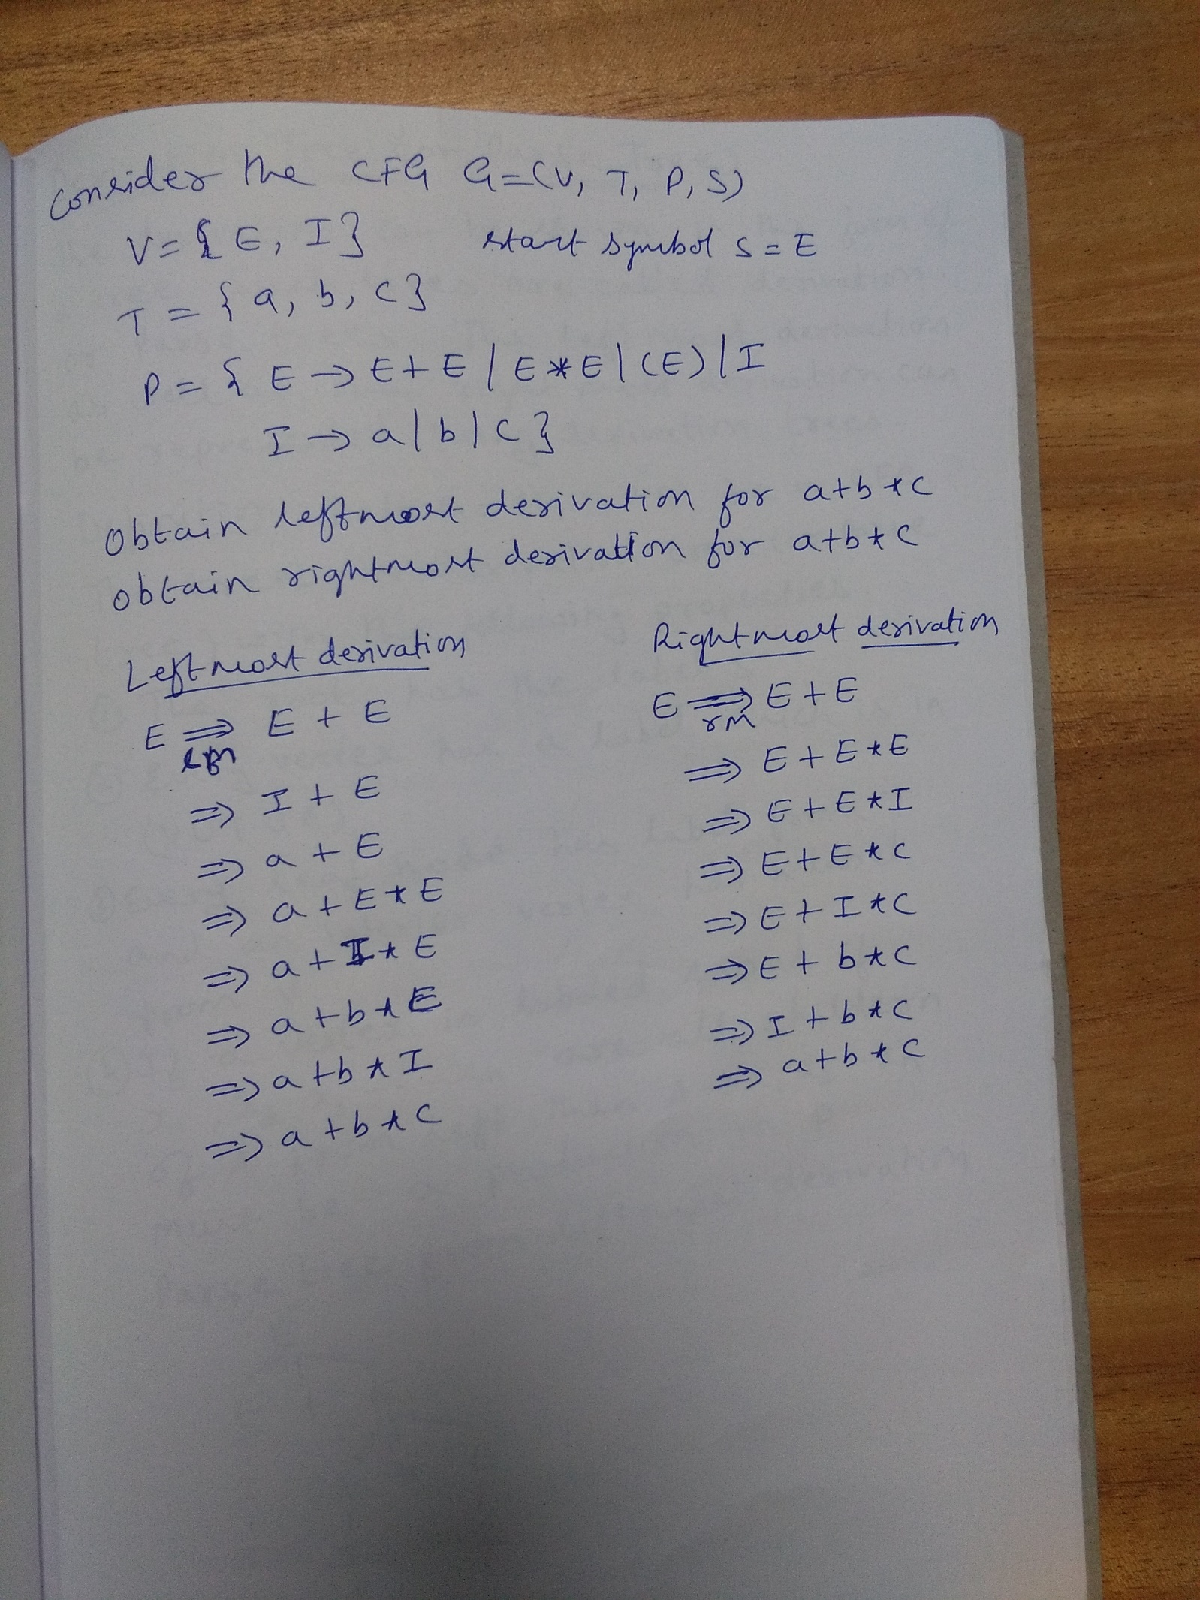

Slide 70
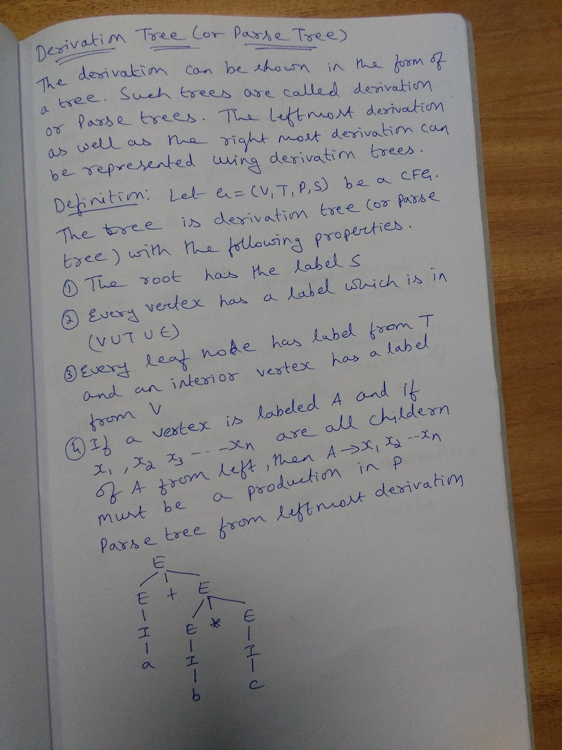

Slide 71
Derivations
The process of deriving strings by applying productions.
Applying productions of a CFG to infer that certain strings are in the language.
First, we expand the start symbol using one of its productions. We further expand the resulting strings by replacing one of the variables and so on, until we derive a string consisting entirely terminals.

Slide 72
Leftmost and Rightmost Derivation of a String
Leftmost derivation − A leftmost derivation is obtained by applying production to the leftmost variable in each step.
Rightmost derivation − A rightmost derivation is obtained by applying production to the rightmost variable in each step.

Slide 73
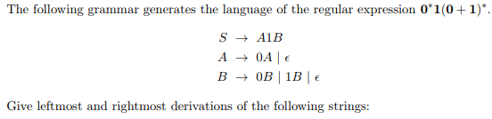
Question
a. 00101 b. 1001 c. 00011

Slide 74
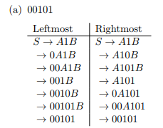
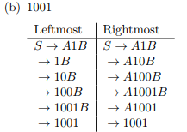
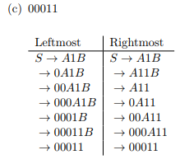
Solution

Slide 75
Derivation tree or parse tree
A derivation tree or parse tree is an ordered rooted tree that graphically represents the semantic information a string derived from a context-free grammar.

Slide 76
Formal Definition of a Derivation Tree:
Let G = (V, T, S, P) be a CFG. An ordered tree is a derivation tree for G if and only if it has the following properties:
The root of the derivation tree is S.
Each and every leaf in the tree has a label from T ∪{ε}.
Each and every interior vertex (a vertex which is not a leaf) has a label from V.
If a vertex has label A ∈ V, and its children are labeled (from left to right) a₁, a₂, .. .. .. .., a_{n}, then P must contain a production of the form A → a₁, a₂, .. .. .. .., a_{n}
A leaf labeled ε has no siblings, that is, a vertex with a child labeled ε can have no other children.

Slide 77
Question
Write Parse Tree for the strings
a. 00101 b. 1001 c. 00011

Slide 78
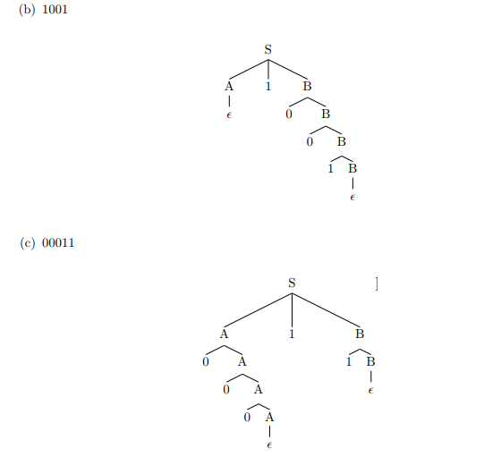
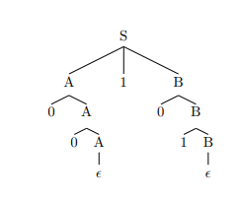
Parse Tree for the string
00101

Slide 79
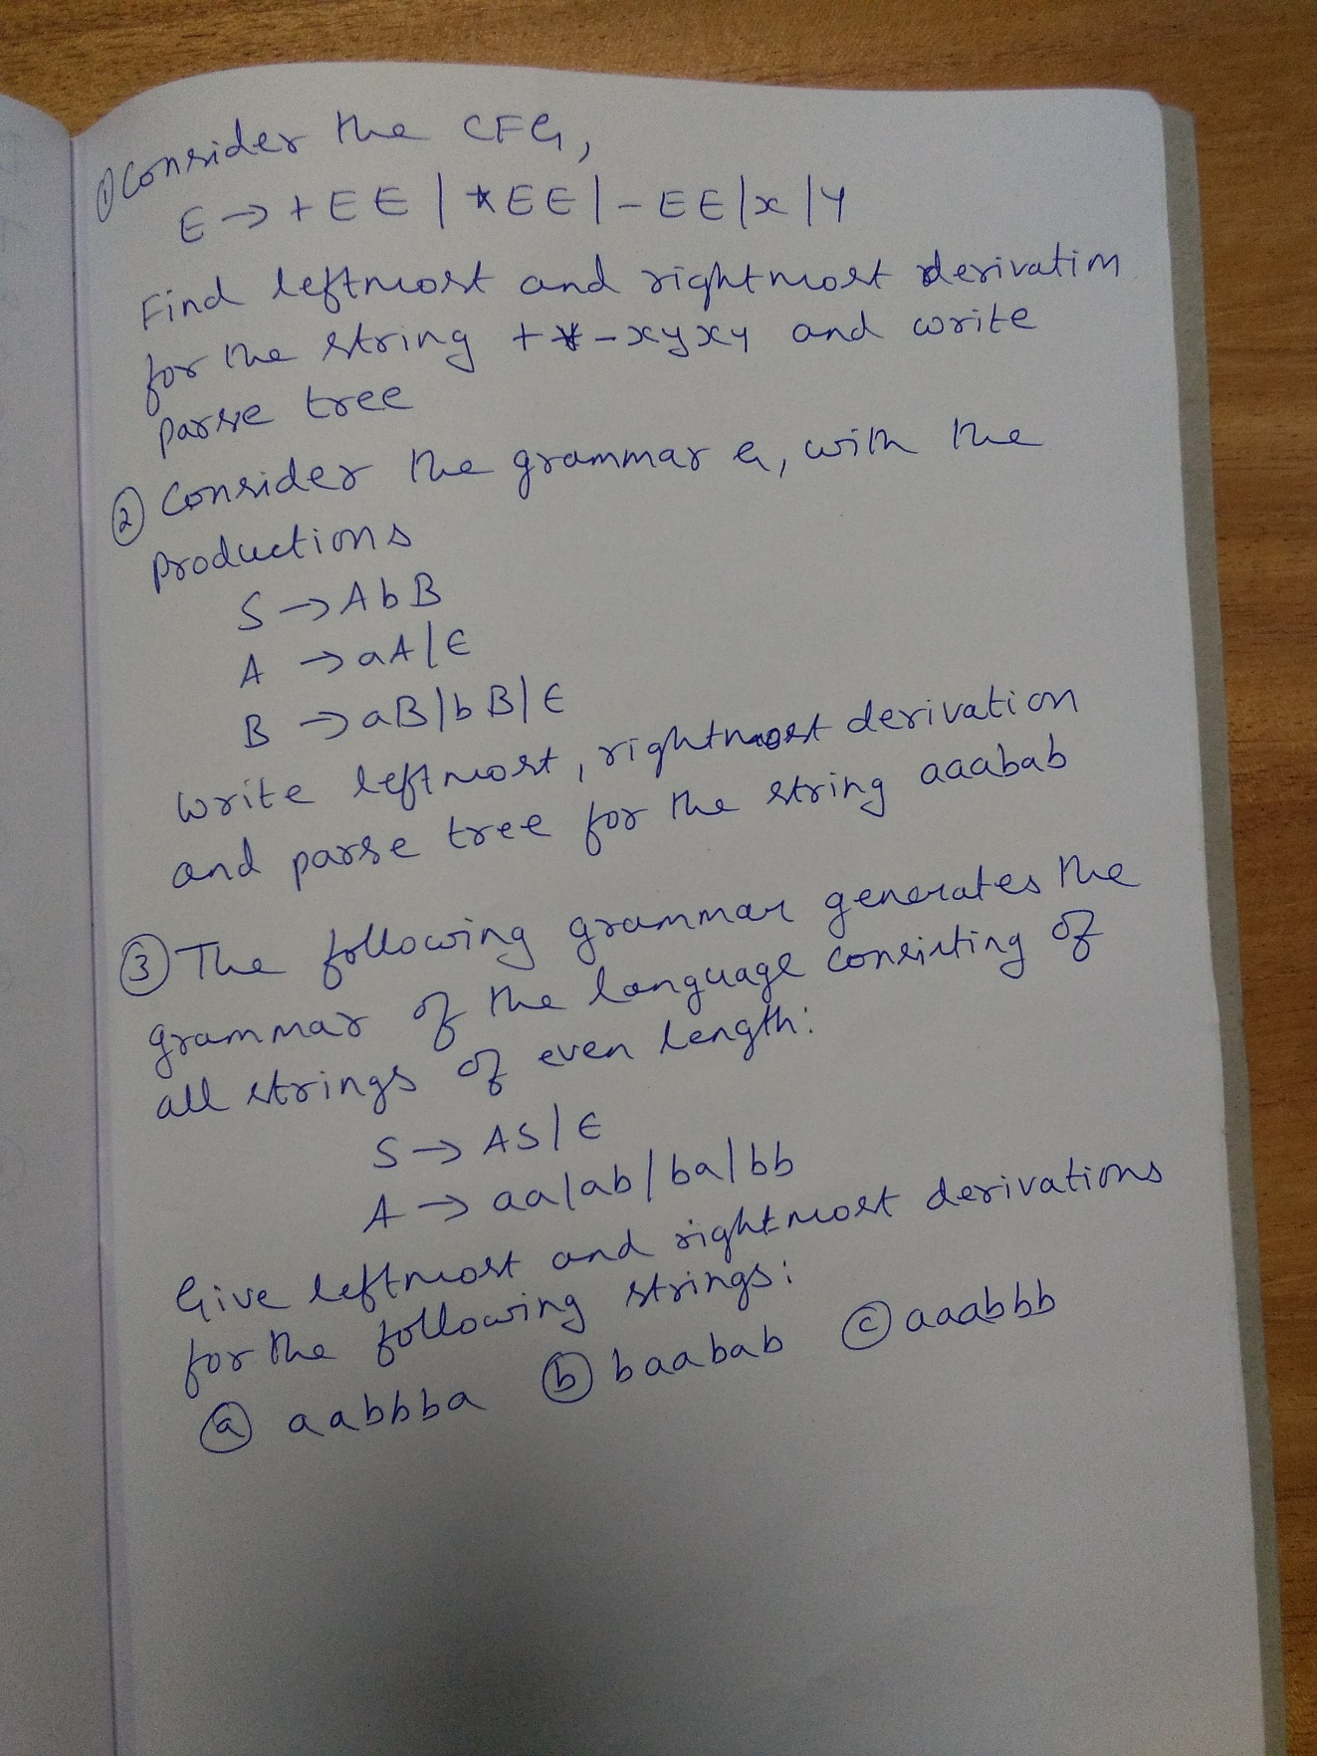

Slide 80
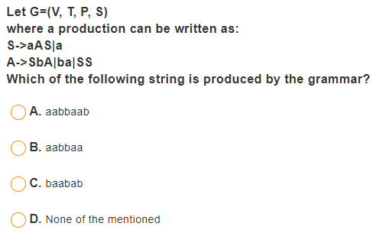
Question
Notes:
Let G = {V, T, P, S} where a production can be written as: S aAS | a , A SbA | ba | SS
Which of the following string is produced by the grammar
a. aabbaab b. aabbaa c. baabab d. None of the Mentioned

Slide 81
Ambiguous Grammar
Ambiguous Grammar: Uncertain nature or open to two or more interpretations.
Let G=(V, T, P, S) be a CFG. A grammar G is ambiguous if and only if there exists at least one string W ∈ T* for which two or more different parse trees exists by applying either leftmost or rightmost derivations.

Slide 82
Example of Ambiguous Grammar
G= (V, T, P, S)
V={E, I} , T={a, b, c, +, *} , S =E
P={ E → E+E | E*E | I ; I → a | b | c }
Two different parse trees exists for the string a+b*c

Slide 83
Unambiguous Grammar: Based on Precedence
G= (V, T, P, S)
V={E, F, I, T} , T={a, b, c, +, *} , S =E
P={
I → a | b | c
F → I
T → T*F | F
E → E+T | T
}
Only one parse tree exists for the string a+b*c

Slide 84
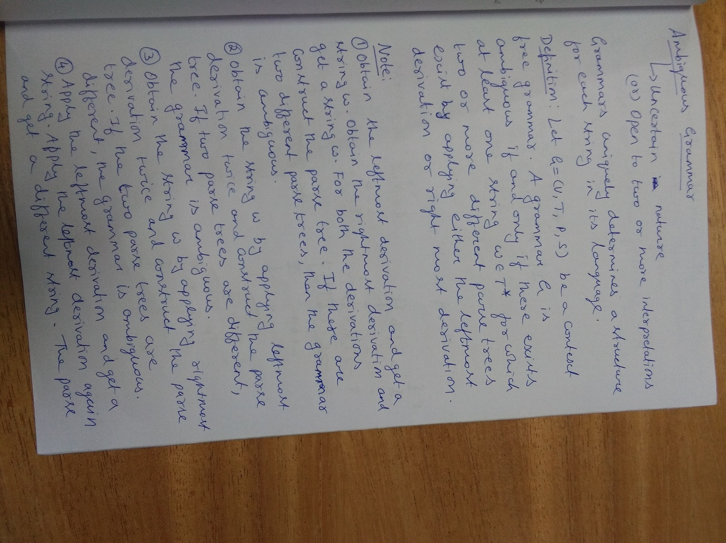

Slide 85
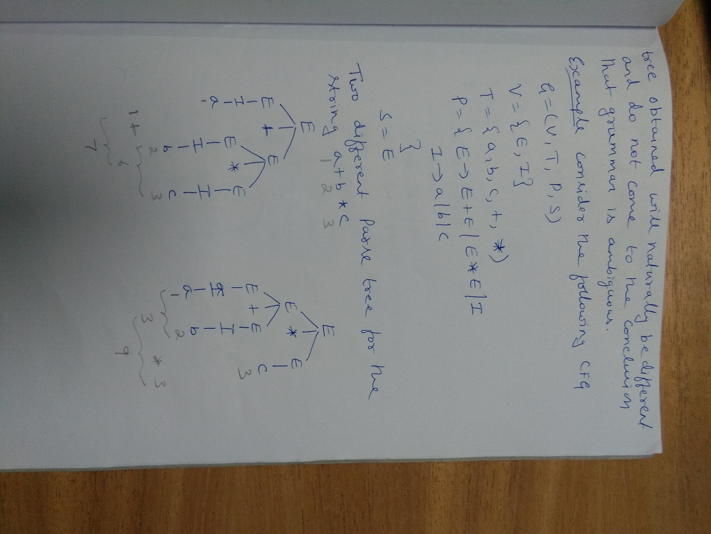

Slide 86
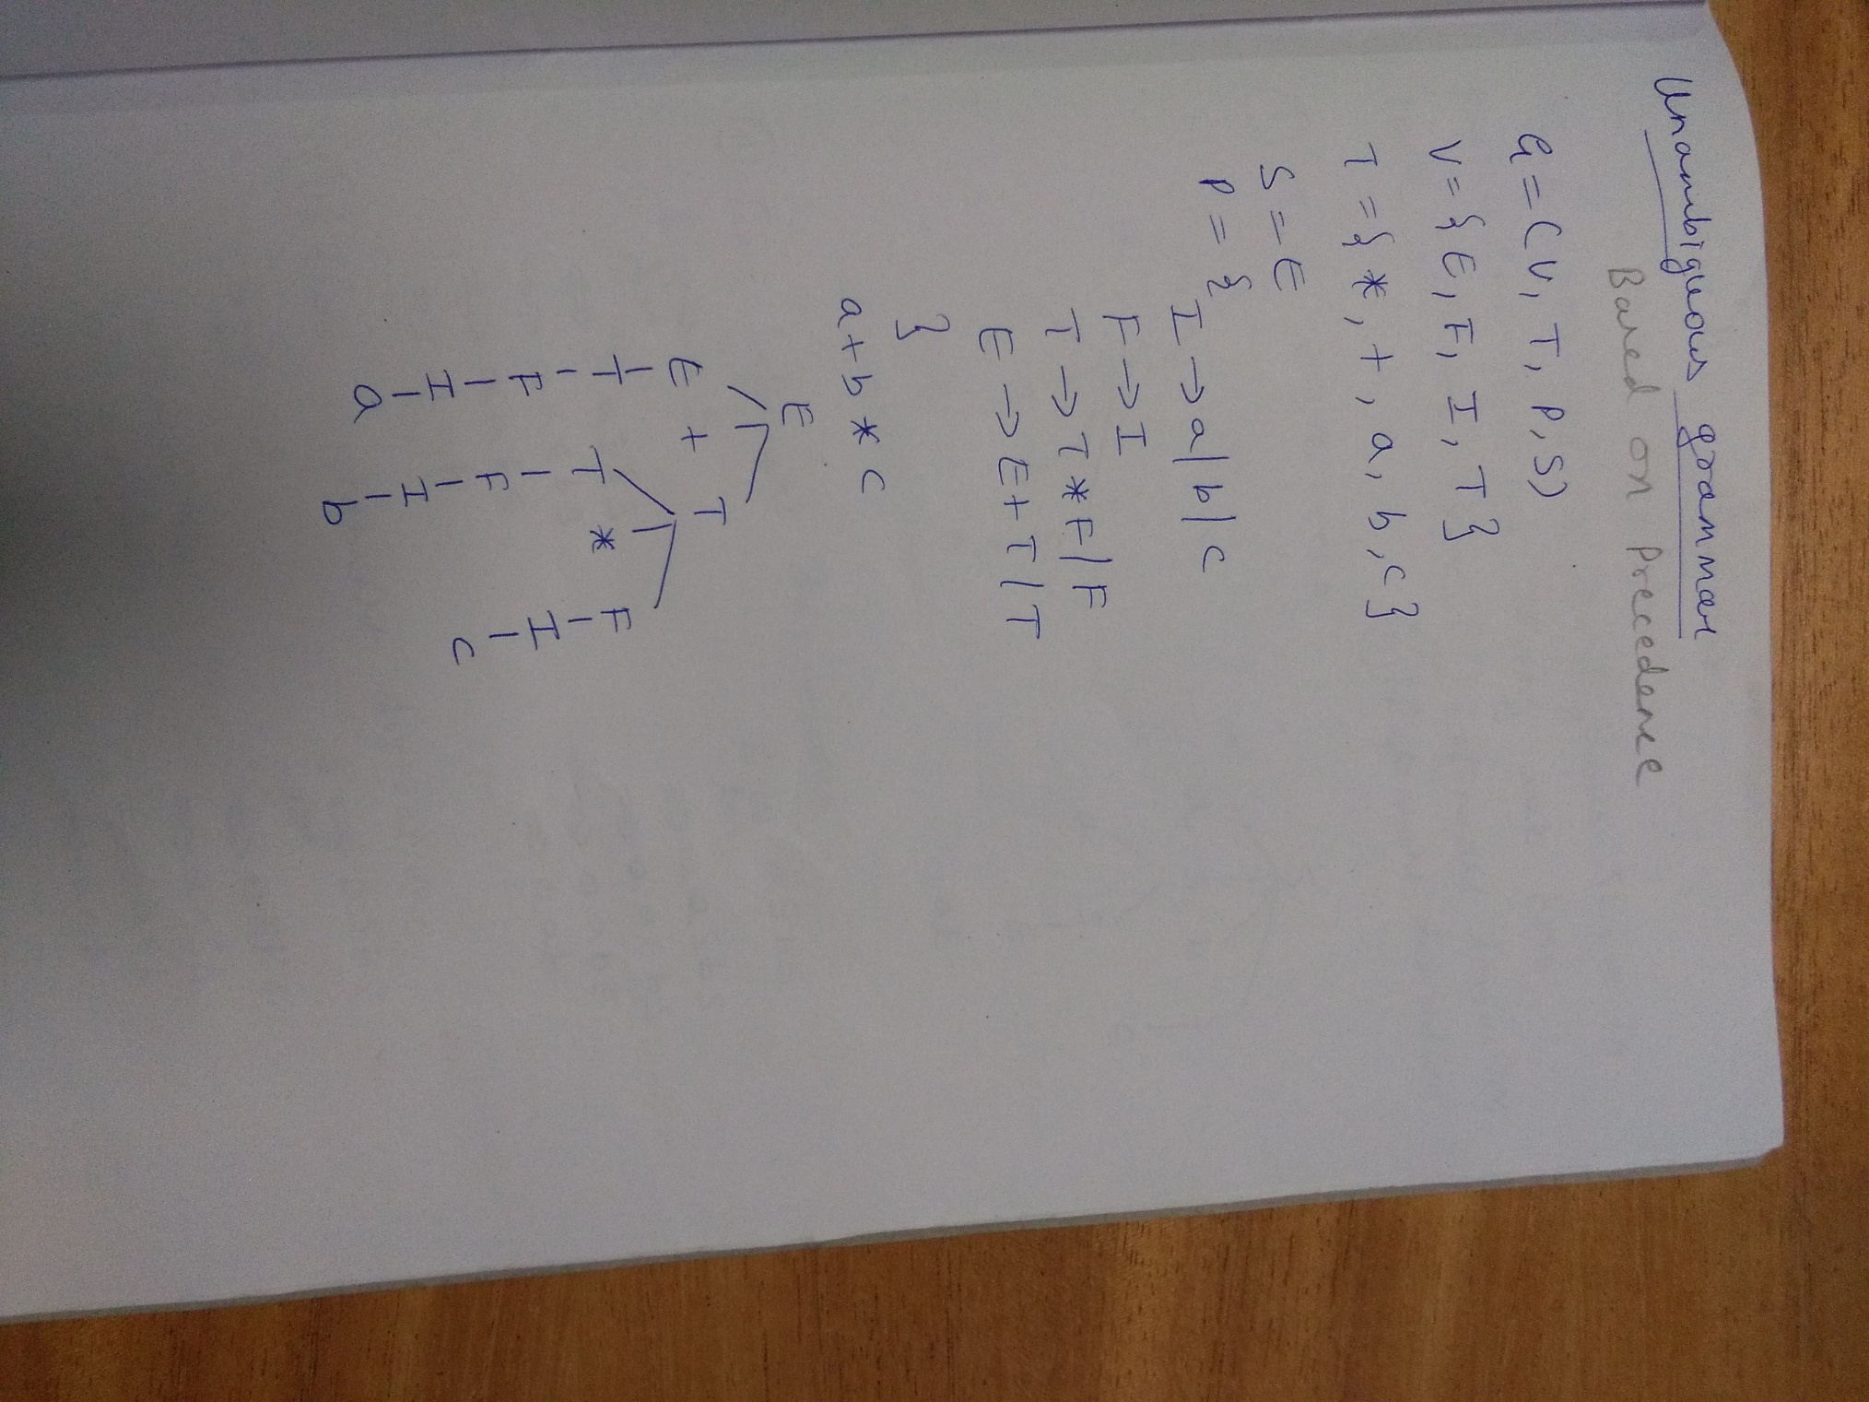

Slide 87
Question
Consider the grammar
S → aS | aSbS | ε
Show that the grammar is ambiguous over the string aab

Slide 88
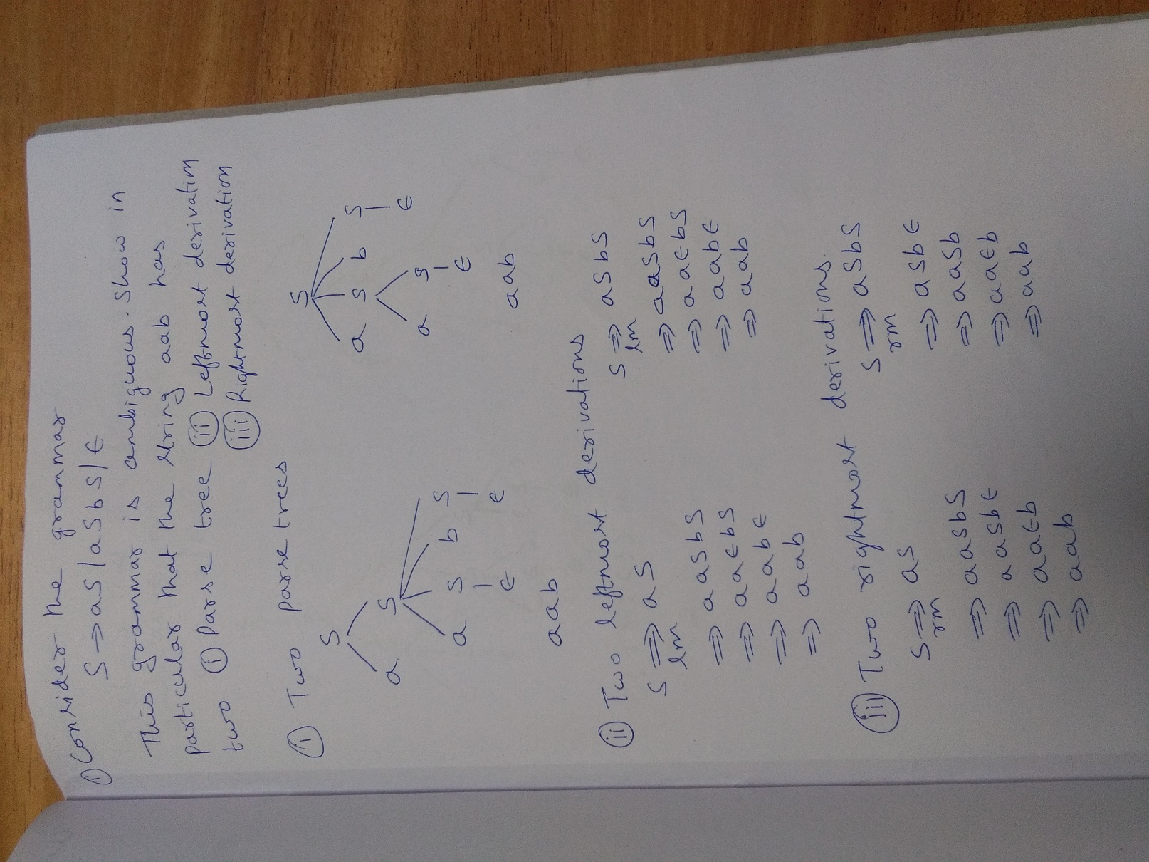

Slide 89
Question
Consider the grammar
G=(V, T, P, S)
V = {S, C} , T={i, t, e, a, b} , S=S
P = { S → iCtS | iCtSeS | a , C → b }
Show that the grammar is ambiguous over the string ibtibtaea

Slide 90
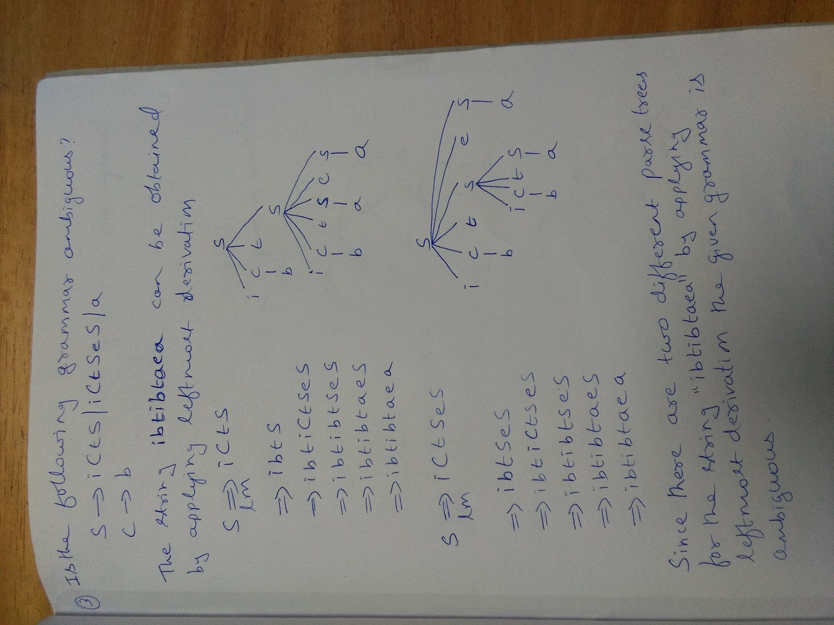

Slide 91
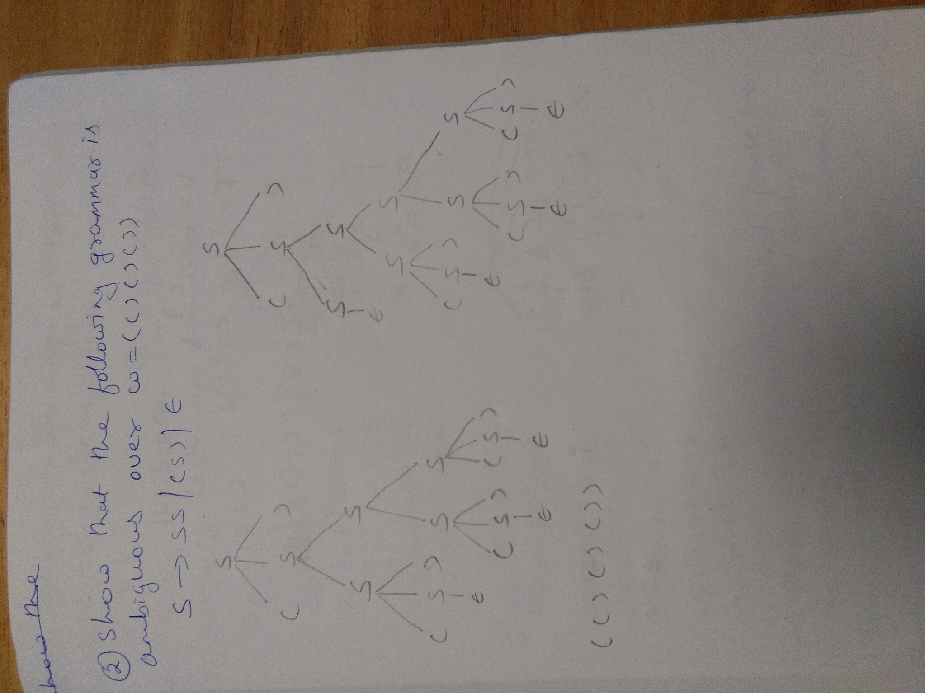

Slide 92
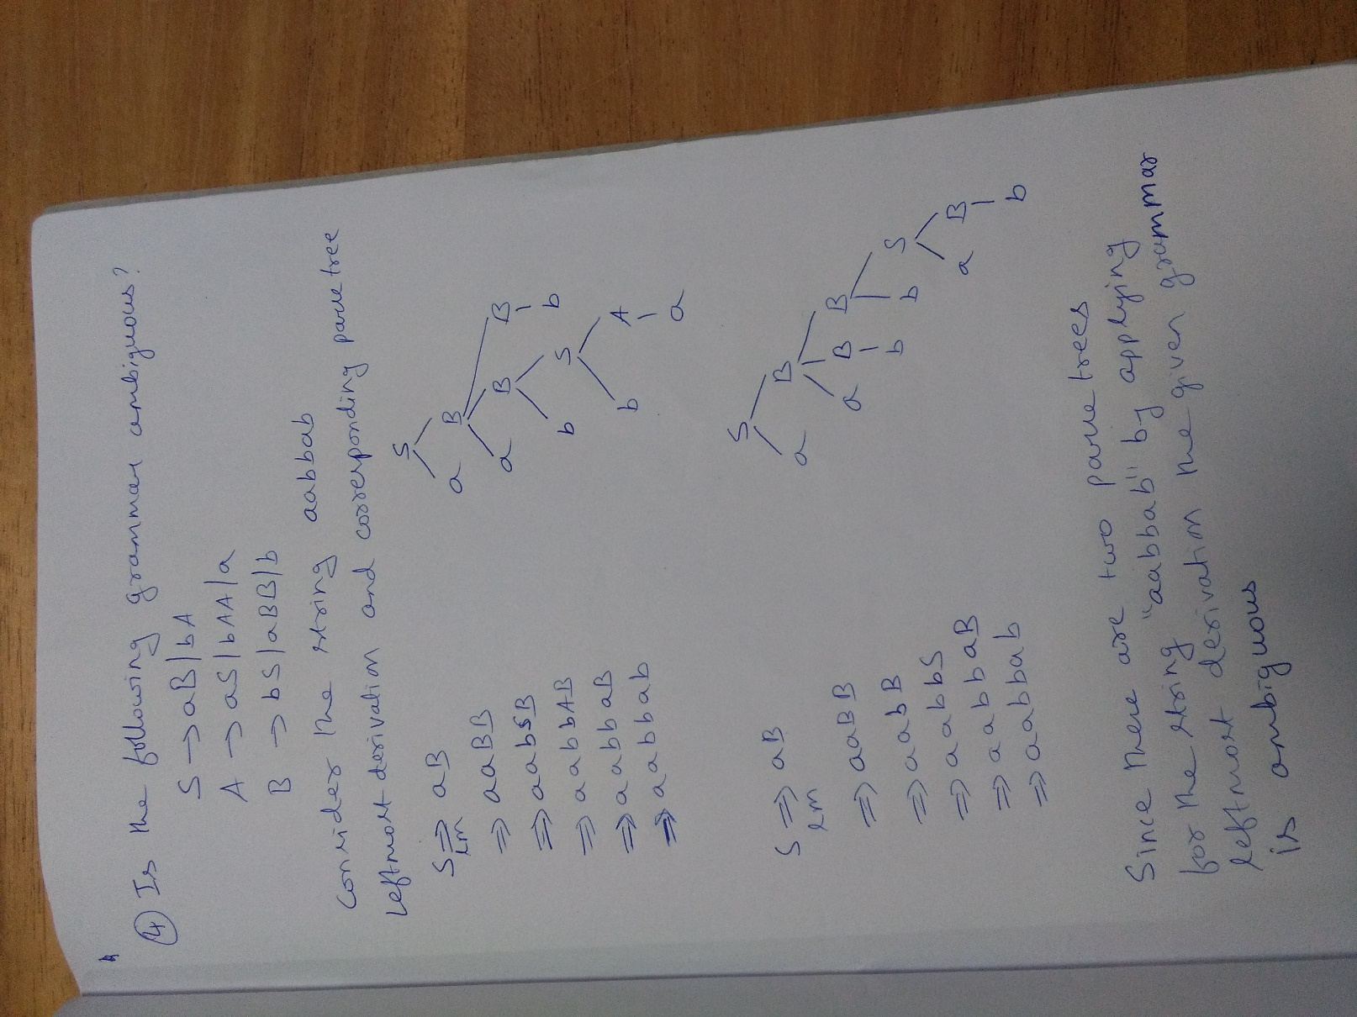

Slide 93
Ambiguous Grammar | Unambiguous Grammar
A grammar is said to be ambiguous if for any string generated by it, it has more than one- parse tree or derivation tree or leftmost derivation or rightmost derivation | A grammar is said to be unambiguous if for all the strings generated by it, it has exactly one- parse tree or derivation tree or leftmost derivation or rightmost derivation
In case of ambiguous grammar, leftmost derivation and rightmost derivation represents different parse trees. | In case of unambiguous grammar, leftmost derivation and rightmost derivation represents the same parse tree.
Ambiguous grammar contains less number of non-terminals. | Unambiguous grammar contains more number of non-terminals.
For ambiguous grammar, length of parse tree is less. | For unambiguous grammar, length of parse tree is large.
Example- E → E + E / E x E / id | Example- E → E + T / T T → T x F / F F → id

Slide 94
Inherently Ambiguous Language
Inherently Ambiguous Language : A context-free language that has no non-ambiguous grammar.
An example is the set {a^{i}b^{j}c^{k} | i = j or j = k}

Slide 95
Question
Grammar that produce more than one Parse tree for same sentence is:
a. Ambiguous
b. Unambiguous
c. Complementation
d. Concatenation Intersection

Slide 96
Question
Grammar that produce more than one Parse tree for same sentence is:
a. Ambiguous
b. Unambiguous
c. Complementation
d. Concatenation Intersection

Slide 97
GATE Exam Question
Consider the following statements about the context free grammar G = {S -> SS, S -> ab, S -> ba, S -> ?} I. G is ambiguous II. G produces all strings with equal number of a’s and b’s
Which combination below expresses all the true statements about G? A. I only B. I and II only

Slide 98
GATE Exam Question
Consider the following statements about the context free grammar G = {S -> SS, S -> ab, S -> ba, S -> ε } I. G is ambiguous II. G produces all strings with equal number of a’s and b’s
Which combination below expresses all the true statements about G? A. I only B. I and II only
Solution : There are different Left Most Derivation’s for string abab which can be S => SS => SSS => abSS => ababS => abab S => SS => abS => abab So the grammar is ambiguous. So statement I is true. Statement II states that the grammar G produces all strings with equal number of a’s and b’s but it can’t generate aabb string. So statement II is incorrect.

Slide 99
Simplification of CFG’s
Eliminating Useless Symbols
Eliminating ε–productions
Eliminating Unit Productions

Slide 100
Eliminating Useless Symbols
In CFG, some of the symbols or productions may not be used to derive a string. Some symbols and productions may not be reachable from the start symbol. So these symbols and productions which are not used in any sentential form are useless and the corresponding productions can be eliminated.
Example: { S → aA | B , A → aA | a , E → b}
The production S → B , a string can never be derived. So, the symbol B and the production S → B are useless and can be eliminated. The production E → b , is not reachable from start symbol S. So the Symbol E , b and the production E → b can be eliminated.
Eliminating useless symbols from the grammar will not change the language generated , so we may as well detect and eliminate all useless symbols.

Slide 101
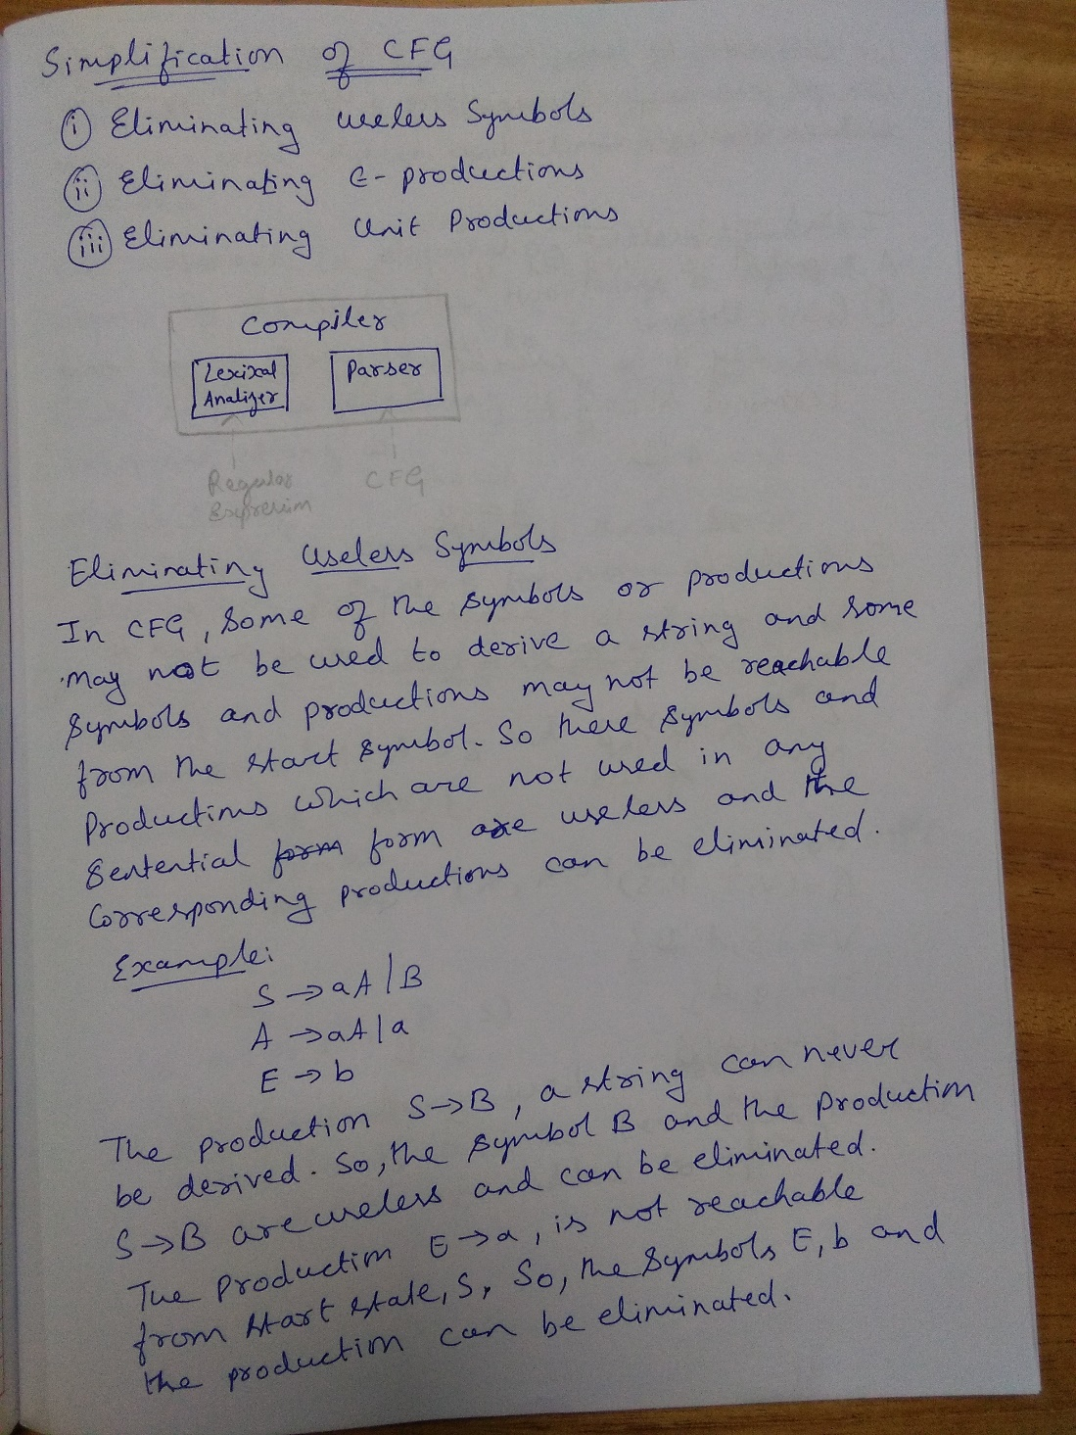

Slide 102
Eliminating Useless Symbols
Our approach to eliminating useless symbols begins by identifying the two things a symbol has to be able to be useful
1. Generating:
We say X is generating if X ⇒ w for some terminal string w
2.Reachable:
We say X is reachable if there is a derivation S ⇒αXβ for some α and β

Slide 103
Algorithm for identifying “Generating” symbols
ov = { }
nv = ov U {A , A → y and y ∈ (ov U T)*}
While (ov != nv) {
ov =nv
nv = ov U {A, A → y and y ∈ (ov U T)*
}
V₁ = ov
G₁=(V₁, T₁, P₁, S)
The productions used to obtain V₁ are added to P₁ and the terminals in these productions are added to T₁.

Slide 104
Algorithm for identifying “Reachable” symbols
V’ = {S}
For each A in V’
If A → β then
Add the variables in β to V’
Add the terminals in β to T’
endif
Endfor
G’ = (V’, T’, P’, S)

Slide 105
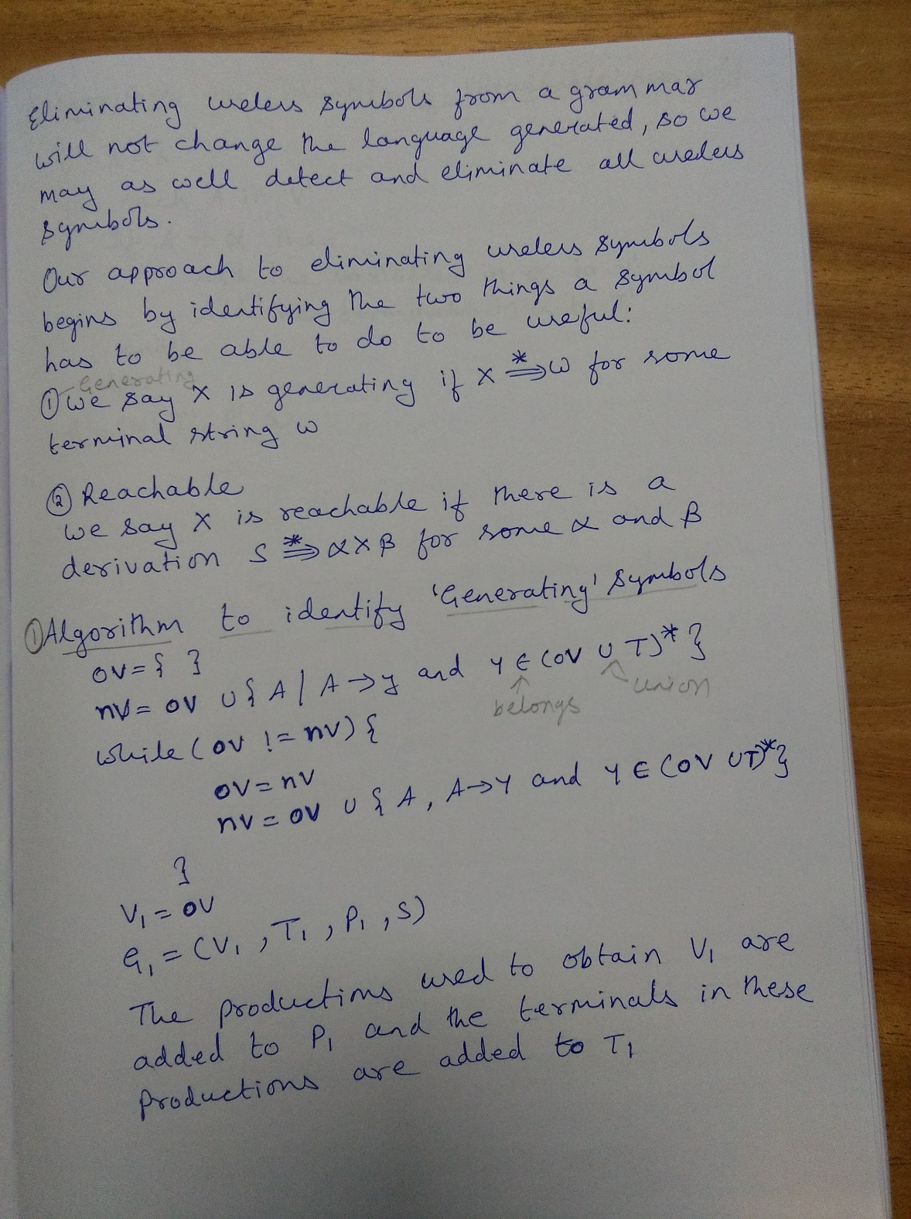

Slide 106
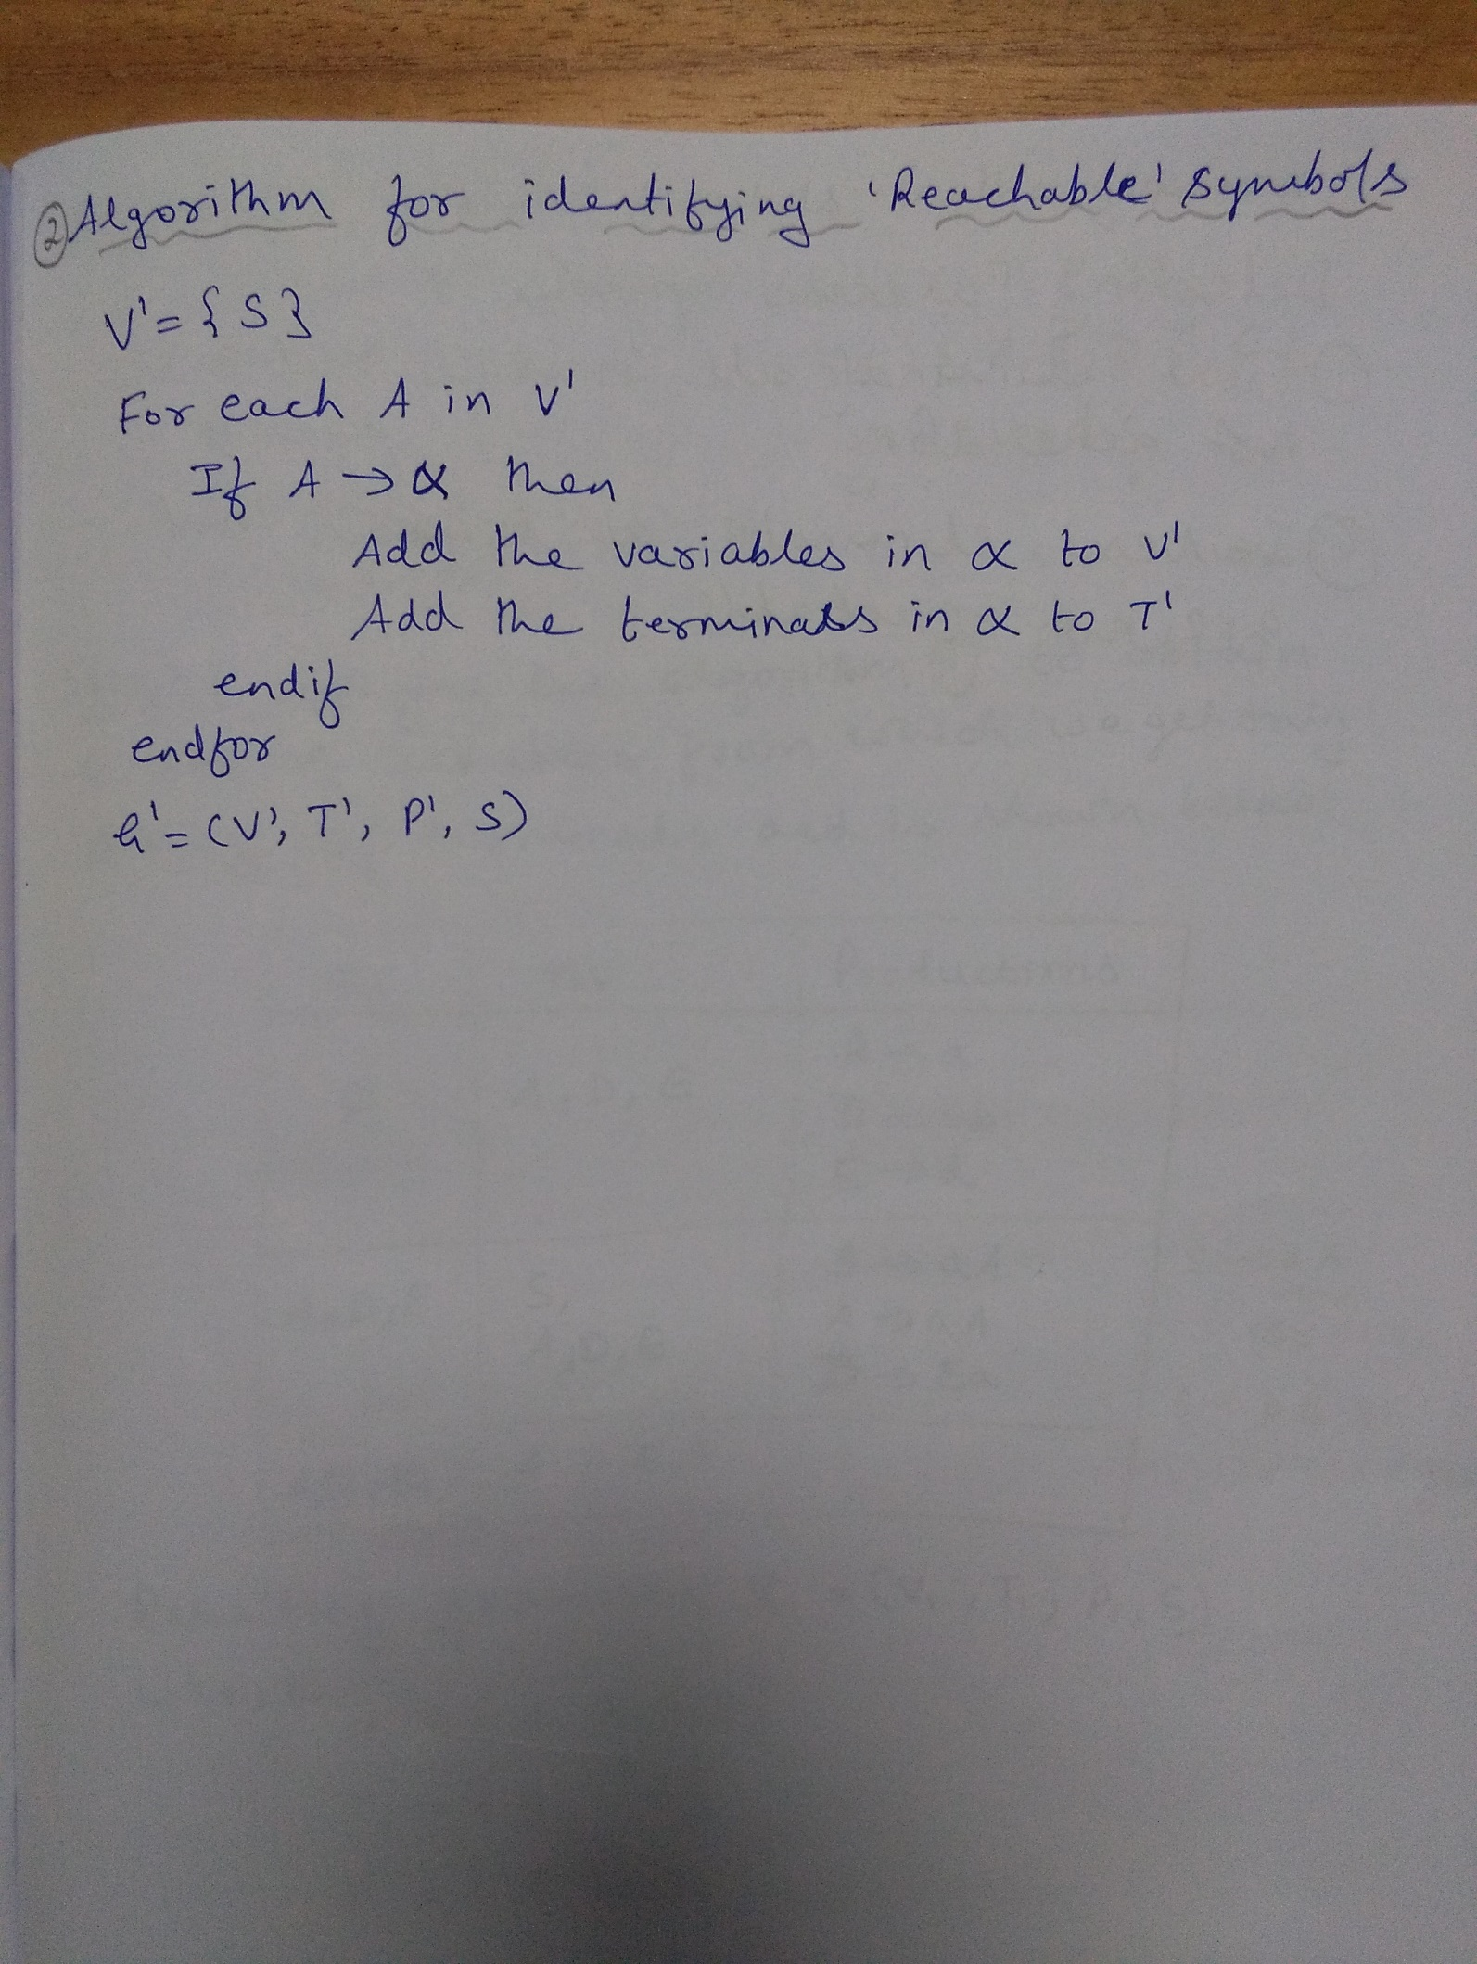

Slide 107
Question
Eliminate Useless symbols in the grammar
G=(V, T, P, S)
V={S, A, B, C, D, E} , T= {a, b, d}, S= S
P={S →aA | bB , A → aA | a ,
B →bB , D →ab | Ea , E →aC | d}

Slide 108
Rough Slide
Algorithm to identify
“Generating” symbols
ov = { }
nv = ov U {A , A → y and y ∈ (ov U T)*}
While (ov != nv) {
ov =nv
nv = ov U {A, A → y and y ∈ (ov U T)*
}
V₁ = ov
G₁=(V₁, T₁, P₁, S)
Step1: Identifying “Generating” symbols
Input Grammar
G=(V, T, P, S)
V={S, A, B, C, D, E} , T= {a, b, d}, S= S
P={S → aA | bB ,
A → aA | a ,
B → bB ,
D → ab | Ea ,
E → aC | d}
ov | nv | Productions
Output Grammar
G₁=(V₁, T₁, P₁, S)

Slide 109
Rough Slide
Algorithm to identify
“Reachable” symbols
V’ = {S}
For each A in V’
If A → β then
Add the variables in β to V’
Add the terminals in β to T’
endif
Endfor
Step2: Identifying “Reachable” symbols
Input Grammar
G₁ = (V₁, T₁, P₁, S)
V1 = {S, A, D, E}
T1 ={a, b, d}
P1= {S →aA ,
A → aA | a ,
D →ab | Ea ,
E →d
P’ | T’ | V’
---------- | ------- | S
Output Grammar
G’ =(V’, T’, P’, S)

Slide 110
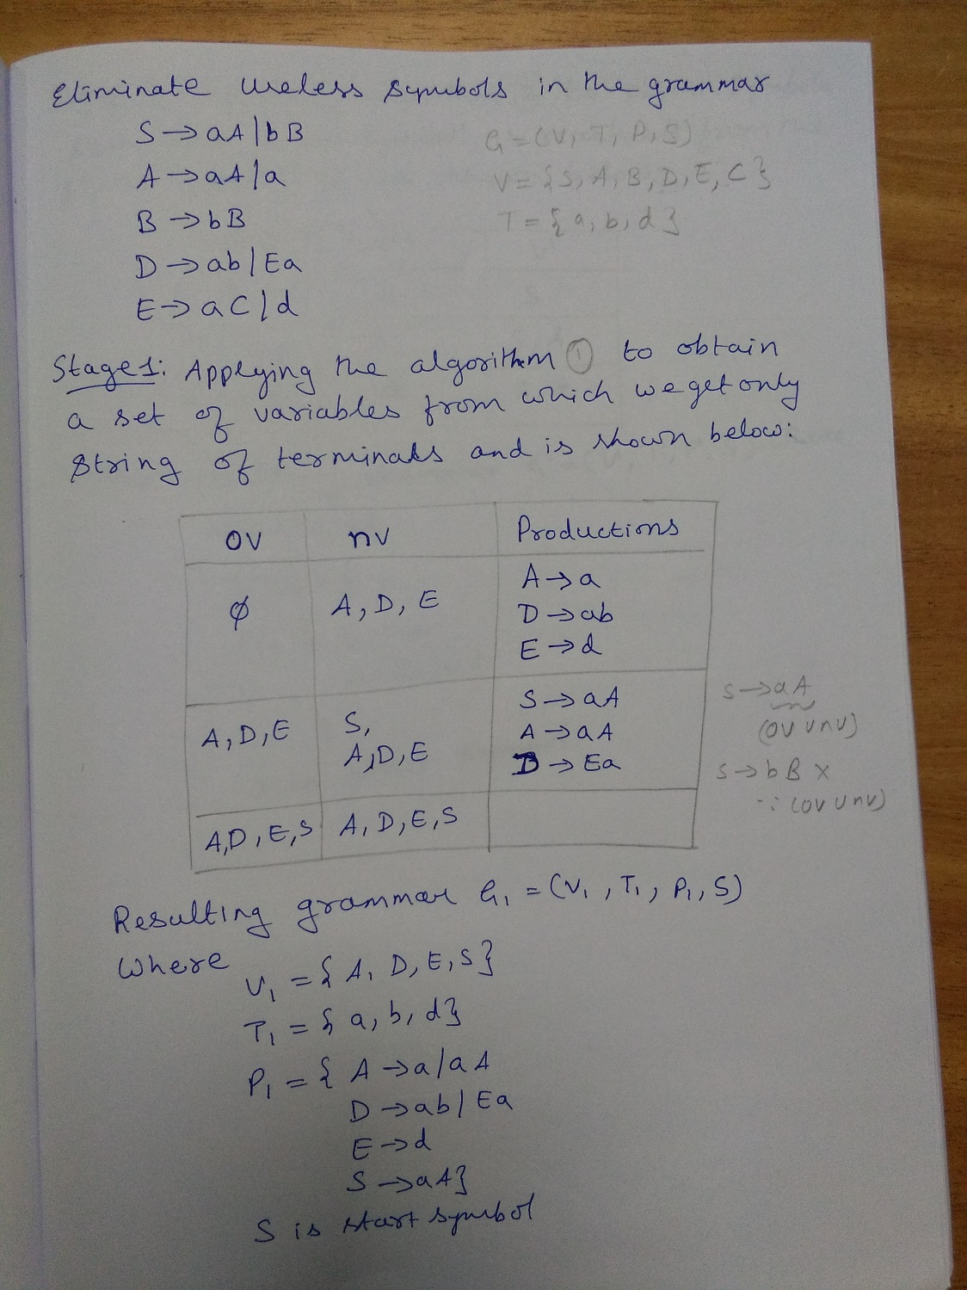

Slide 111
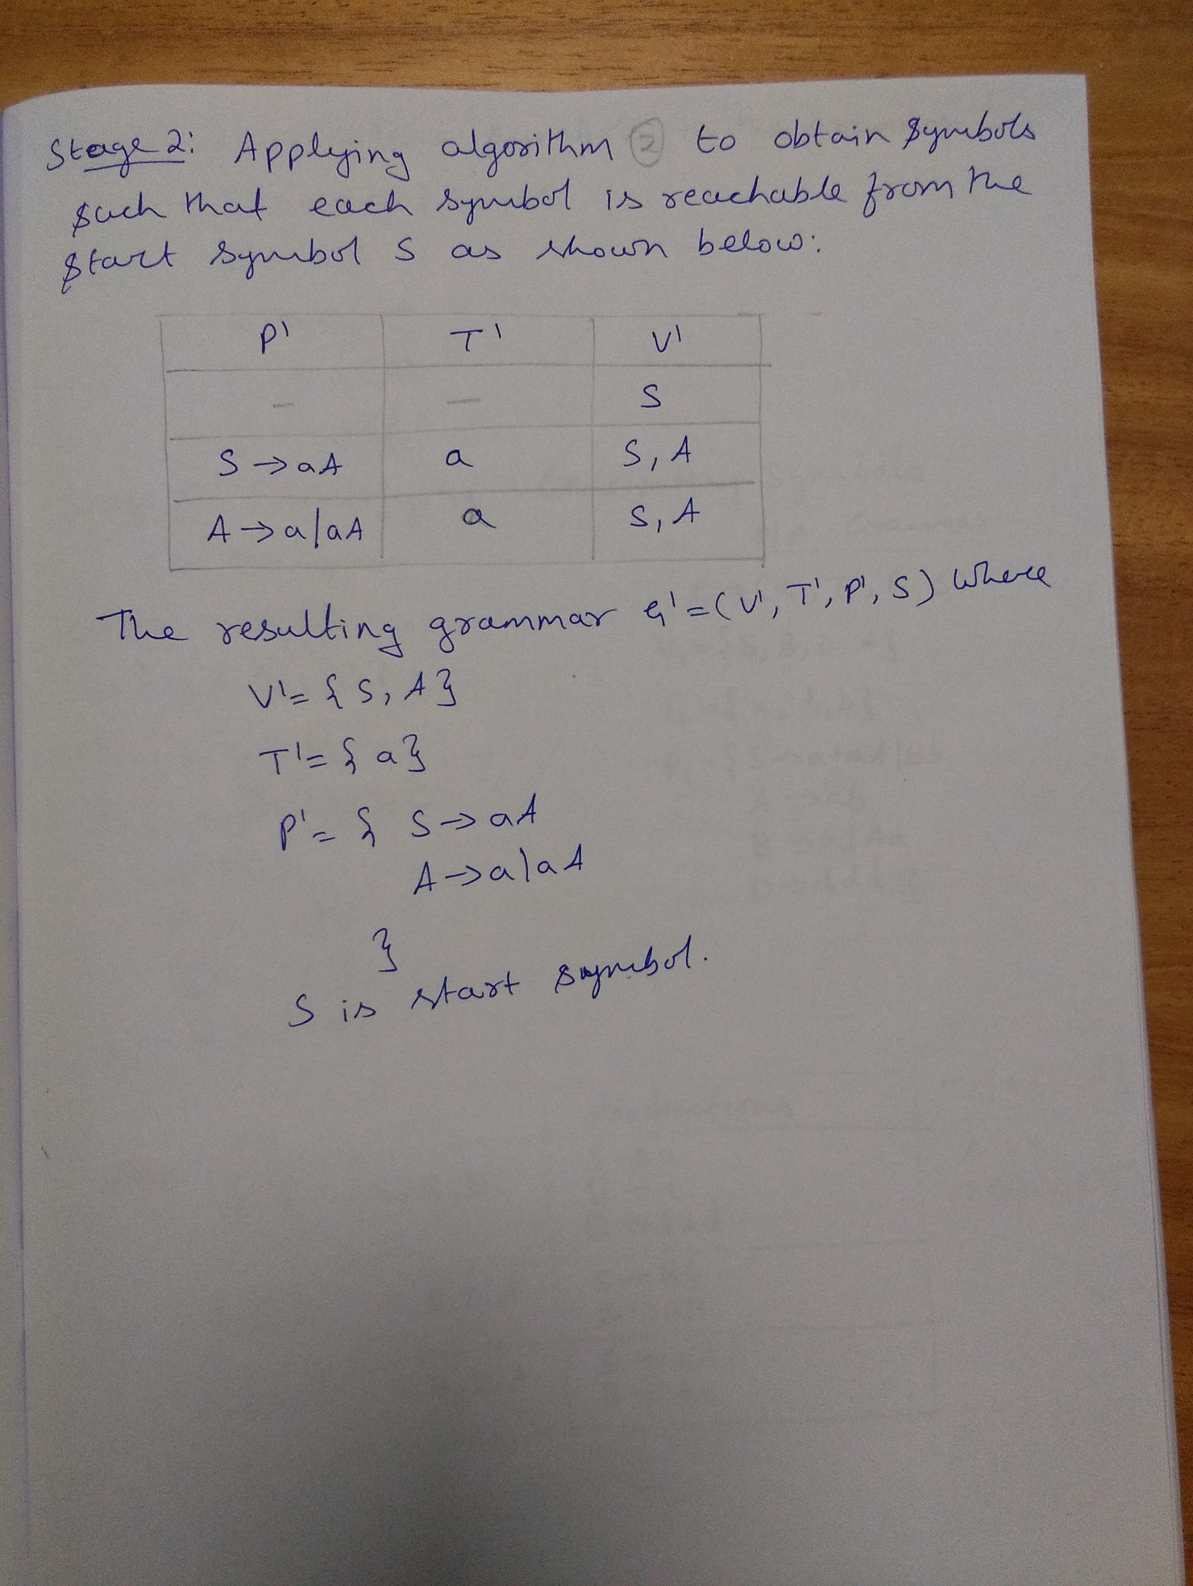

Slide 112
Question
Eliminate Useless symbols in the grammar
G=(V, T, P, S)
V={S, A, B, C, D} , T= {a, b, c, d}, S= S
P={S →aA | a | Bb | cC
A → aB
B →a | Aa
C →cCD
D → ddd}

Slide 113
Rough Slide
Algorithm to identify
“Generating” symbols
ov = { }
nv = ov U {A , A → y and y ∈ (ov U T)*}
While (ov != nv) {
ov =nv
nv = ov U {A, A → y and y ∈ (ov U T)*
}
V₁ = ov
G₁=(V₁, T₁, P₁, S)
Step1: Identifying “Generating” symbols
Input Grammar
G=(V, T, P, S)
V={S, A, B, C, D} , T= {a, b, c, d}, S= S
P={
S →aA | a | Bb | cC
A → aB
B →a | Aa
C →cCD
D → ddd }
ov | nv | Productions
Output Grammar
G₁=(V₁, T₁, P₁, S)

Slide 114
Rough Slide
Algorithm to identify
“Reachable” symbols
V’ = {S}
For each A in V’
If A → β then
Add the variables in β to V’
Add the terminals in β to T’
endif
Endfor
Step2: Identifying “Reachable” symbols
Input Grammar
G₁ = (V₁, T₁, P₁, S)
V1 = {S, A, B, D}
T1 = {a, b, d}
P1 = { S → a | aA | Bb
B → a | Aa
D → ddd
A → aB
P’ | T’ | V’
---------- | ------- | S
Output Grammar
G’ =(V’, T’, P’, S)

Slide 115
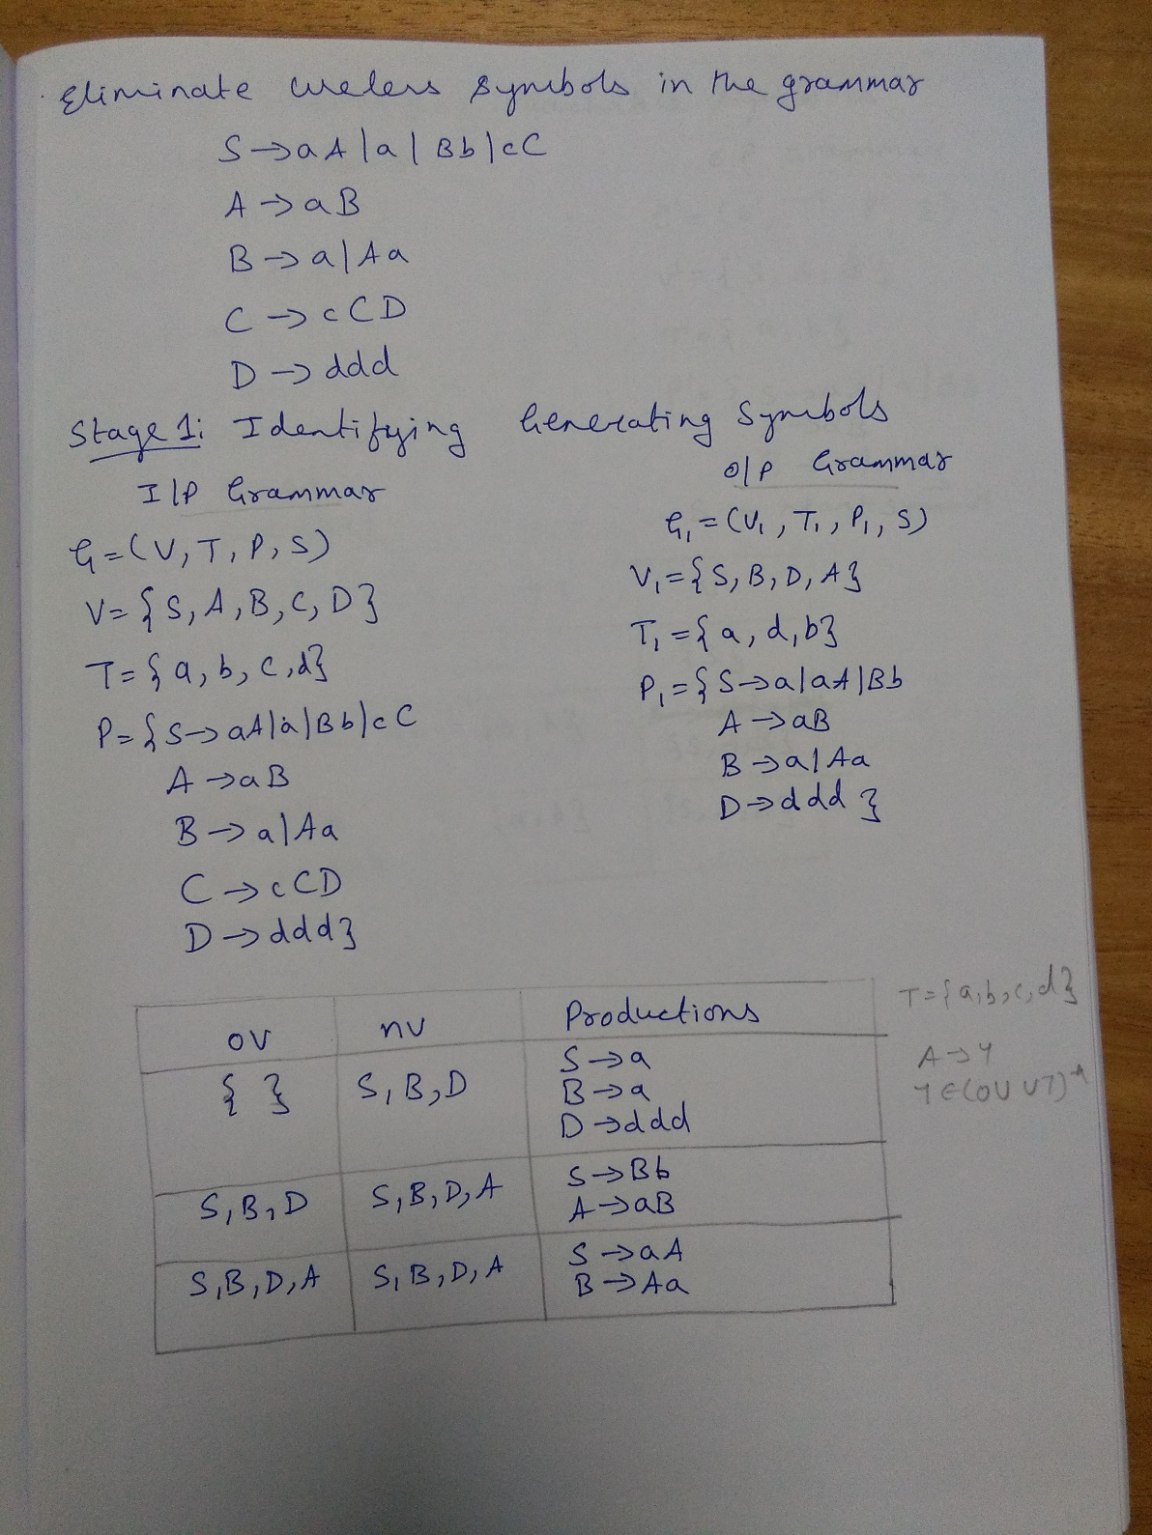

Slide 116
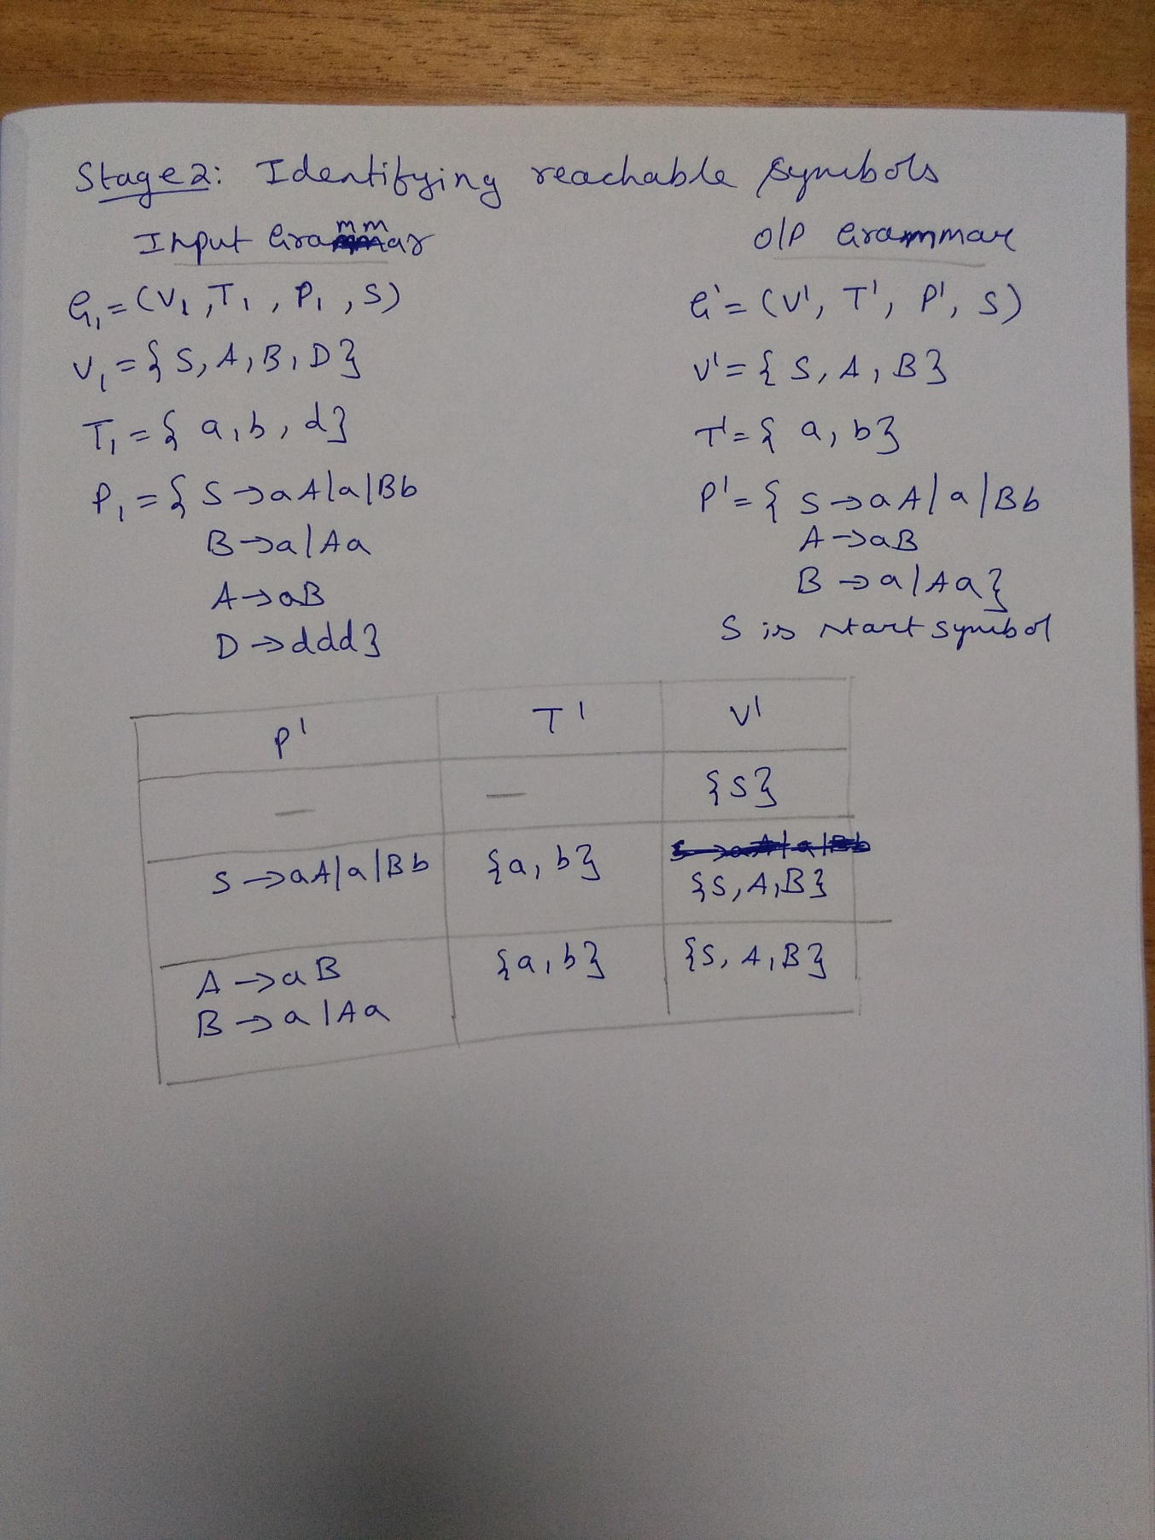

Slide 117
Eliminating ε–productions

Slide 118
Eliminating ε–productions
A production of the form A → ε is undesirable in a CFG, unless an empty string is derived from the start symbol. Suppose , the language generated from a language grammar G does not derive any empty string and grammar consists of ε-productions. Such ε-productions can be removed.

Slide 119
Nullable Variables
Example:
i. A → ε : A is nullable variable
ii. A → BC , B → ε , C→ ε : A, B, C, are nullable variables
Definition:
Let G =(V , T, P, S) be a CFG. A null able variable is defined as follows:
i. If A → ε is a production in P and then A is nullable variable
ii. If A → B₁B₂…Bn is a production in P, and if B_{1 ,} B₂…..Bn are nullable variables then A is also nullable variable.
Even though a grammar G has some ε-productions and the language may not derive an empty string. So, in such cases , the ε-productions are not needed and they can be eliminated.

Slide 120
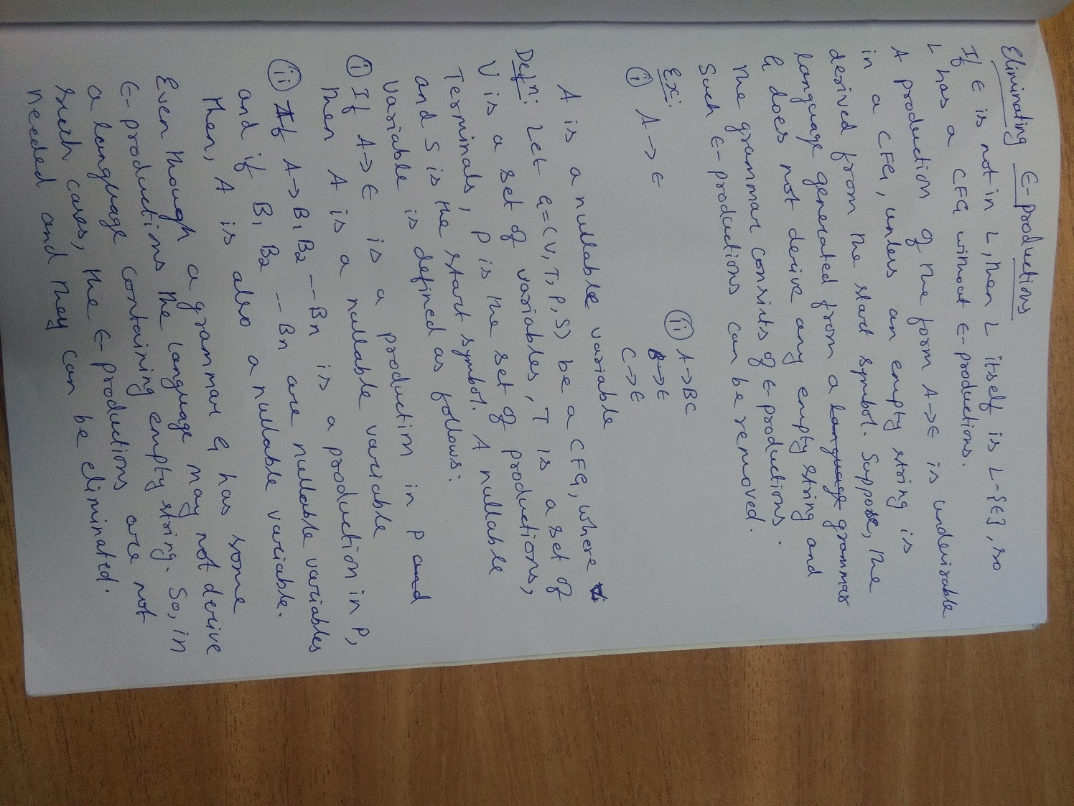

Slide 121


Slide 122


Slide 123
Eliminating ε-Productions or Null-Productions
Let G=(V,T,P, S) where L(G) != ε . We effectively find an equivalent grammar G’ with no ε-productions or NULL productions such that L(G’)=L(G)- ε
Step1: Find set of Nullable variables in the grammar G using the following algorithm
ov ={}
nv ={A | A-> ε}
While(ov != nv)
{
ov = nv
nv = ov ∪ {A | A-> β and β ∈ ov*}
}
V= ov
Once the control comes out of the while loop, the set V contains the only nullable variables.

Slide 124
Eliminating ε-Productions (Contd…)
Step 2: Construction of productions P’ . Consider a production of the form
A -> X₁X₂……X_{n} , n>=1
Where each X_{i} is in (V ∪ T). In a production, take all possible combinations of nullable variables and replace the nullable variables with ε one by one and add the resulting productions to P’ . If the given production is not an ε-Production, add it to P’
Suppose, A and B are nullable variables in the production, then
i. First add the production to P’
ii. Replace A with ε in the given production and add resulting production to P’
iii. Replace B with ε in the given production and add resulting production to P’
iv. Replace A and B with ε and add resulting production to P’
v. If all symbols on the right side of the production are nullable variables, the resulting production is an ε production and do not add this to P’

Slide 125
Question
Eliminate ε-Productions from the grammar
S → ABCa | bD
A → BC | b
B → ε | b
C → ε | c
D → d

Slide 126
Rough Slide
Algorithm to identify
“Nullable” variables
ov ={}
nv ={A | A-> ε}
While(ov != nv)
{
ov = nv
nv = ov ∪ {A | A-> β and β ∈ ov*}
}
V= ov
Step1: Identifying “Nullable” variables
Input Grammar
G=(V, T, P, S)
V={S, A, B, C, D} , T= {ε , a, b, c, d}, S= S
P={
S → ABCa | bD
A → BC | b
B → ε | b
C → ε | c
D → d }
ov | nv | Productions

Slide 127
Rough Slide
Nullable variables: A, B, C
Step2: Constructing the productions P’
Productions | Resulting Productions P’
S → ABCa
S → bD
A → BC
A → b
B → ε | b
C → ε | c
D → d
Input Grammar
G=(V, T, P, S)
V={S, A, B, C, D} , T= {ε , a, b, c, d}, S= S
P={
S → ABCa | bD
A → BC | b
B → ε | b
C → ε | c
D → d }
Ouput Grammar
G=(V’, T’, P’, S)
V’={S, A, B, C, D} , T’= { a, b, c, d}, S= S
P’

Slide 128
Question
Eliminate ε-Productions from the grammar
S → BAAB
A → 0A2 | 2A0 | ε
B → AB | 1B | ε

Slide 129
Rough Slide
Algorithm to identify
“Nullable” variables
ov ={}
nv ={A | A-> ε}
While(ov != nv)
{
ov = nv
nv = ov ∪ {A | A-> β and β ∈ ov*}
}
V= ov
Step1: Identifying “Nullable” variables
Input Grammar
G=(V, T, P, S)
V={S, A, B} , T= {ε ,0, 1, 2}, S= S
P={
S → BAAB
A → 0A2 | 2A0 | ε
B → AB | 1B | ε }
ov | nv | Productions

Slide 130
Rough Slide
Nullable variables: S, A, B
Step2: Constructing the productions P’
Productions | Resulting Productions P’
S → BAAB
A → 0A2
A → 2A0
A → b
A → ε
B → AB
B → 1B
B → | ε
Input Grammar
G=(V, T, P, S)
V={S, A, B} , T= {ε ,0, 1, 2}, S= S
P={
S → BAAB
A → 0A2 | 2A0 | ε
B → AB | 1B | ε }
Ouput Grammar
G=(V’, T’, P’, S)
V’={S, A, B} , T’= { 0, 1, 2}, S= S
P’

Slide 131

A, B,C
A, B,C

Slide 132


Slide 133


Slide 134

Question

Slide 135

Question

Slide 136


Question
Eliminate ε-productions from the grammar
Answer:

Slide 137
Eliminating Unit Productions

Slide 138
Eliminating Unit Productions
Consider the production A → B . The left hand side of the production and the right hand side of the production contains only one variable. Such productions are called unit productions.
Example:
A → B : Unit productions
B → aB | b : Non-unit productions
For, A → B , B → aB | b
Since B is generated from B, what ever is generated by B, the same things can be generated from A also. So, we can have A → aB | b
and the production A → B can be deleted.

Slide 139
Procedure for eliminating Unit Productions
Let G=(V, T, P,S) be a CFG and has unit productions and no ε–productions. An equivalent grammar G₁ without unit productions can be obtained such that L(G)=L(G₁) i.e., any language generated by G can also be generated by G₁. But, the grammar G₁ has no unit productions.
A unit production in grammar G can be eliminated using the following steps:
1. Remove all the productions of the form A → A
2. Add all non unit productions to P₁
3. For each variable A , find all variables B such that A ⇒ B i.e., in the derivation process A, if we encounter only one variable in a sentential form say B (no terminals should be there), obtain all such variables.
4. Obtain a dependency graph. For example if we have the productions A →B, B → C, C →B. The dependency graph will be of the form
5. Note from the dependency graph
a. A ⇒ B i.e., B can be obtained from A. So, all non unit productions generated from B can also be generated from A
b. A ⇒ C i.e., C can be obtained from A. So, all non unit productions generated from C can also be generated from A
c. Similarly for B ⇒ C and C ⇒ B
A
B
C

Slide 140


Slide 141


Slide 142
Question
Eliminate all unit productions from the Grammar
S → AB
A → a
B → C | b
C → D
D → E | bC
E → d | Ab

Slide 143
Rough Slide
Unit Productions of G
Dependency Graph
Input Grammar
G=(V, T, P, S)
V={S, A, B, C, D} , T= {a, b, c, d}, S= S
P={
S → AB , A → a , B → C | b
C → D , D → E | bC , E → d | Ab
}
Non-Unit Productions of G

Slide 144
Rough Slide
Input Grammar
G=(V, T, P, S)
V={S, A, B, C, D} , T= {a, b, c, d}, S= S
P={
S → AB , A → a , B → C | b
C → D , D → E | bC , E → d | Ab
}
Output Grammar
G’=(V’, T’, P’, S)
V={S, A, B, C, D} , T= {a, b, d}, S= S
P={
S → AB , A → a , B → b | d | Ab | bC
C → d | Ab | bC , D → d | Ab | bC , E → d | Ab
}

Slide 145


Slide 146


Slide 147
Question
Eliminate all unit productions from the Grammar
G=(V, T, P,S)
V ={S, A, B} , T ={0,1,2}
P={
S → A0 | B
B → A | 11
A → 0 | 12 | B
}

Slide 148


Slide 149


Slide 150


Slide 151
GATE Exam question
What is the maximum number of reduce moves that can be taken by a derivation process for a grammar with no epsilon- and unit-production (i.e., of type A -> є and A -> a | B) to derive a string with n tokens ? (A) n/2 (B) n-1 (C) 2n-1 (D) 2^{n}

Slide 152
Answer
What is the maximum number of reduce moves that can be taken by a derivation process for a grammar with no epsilon- and unit-production (i.e., of type A -> є and A -> a | B) to derive a string with n tokens ? (A) n/2 (B) n-1 (C) 2n-1 (D) 2^{n}
Answer: (B)

Slide 153
Answer
Answer: (B) (n-1) Explanation: Given in the question, a grammar with no epsilon- and unit-production (i.e., of type A -> є and A -> a).
To get maximum number of Reduce moves, we should make sure than in each sentential form only one terminal is reduced. Since there is no unit production, so last 2 tokens will take only 1 move.
So To Reduce input string of n tokens, first Reduce n-2 tokens using n-2 reduce moves and then Reduce last 2 tokens using the productions. So total of n-2+1 = n-1 Reduce moves.

Slide 154
Answer (Contd…)
Suppose the string is abcd. ( n = 4 ).
We can write the grammar which accepts this string as follows:
S->aB , B->bC , C->cd
The Right Most Derivation for the above is:
S -> aB ( Reduction 3 ) -> abC ( Reduction 2 ) -> abcd ( Reduction 1 )
We can see here that no production is for unit or epsilon. Hence 3 reductions here.
We can get less number of reductions with some other grammar which also does’t produce unit or epsilon productions,
S->abA , A-> cd
The Right Most Derivation for the above as:
S -> abA ( Reduction 2 ) -> abcd ( Reduction 1 )
Hence 2 reductions.
But we are interested in knowing the maximum number of reductions which comes from the 1st grammar. Hence total 3 reductions as maximum, which is ( n – 1) as n = 4 here.
Thus, Option B.
Notes:
S -> abA ( Reduction 2 ) -> abcd ( Reduction 1 )

Slide 155
Order of Simplification of CFG
Eliminating ε-productions
Eliminating Unit Productions
Eliminating Useless Symbols

Slide 156

Question

Slide 157
Answer
Step 1) Remove epsilon productions. we get .. S-> Aa | B B-> a| bC | b C -> a

Slide 158
Answer
Step 2) Remove unit productions .
S->B is the only unit production here we get S-> Aa | a | bC | b B-> a | bC | b C -> a

Slide 159
Answer
Step 2) Remove unit productions .. S->B is the only unit production here we get .. S-> Aa | a | bC | b B-> a | bC | b C -> a
Step 3) Removing useless symbols we cannot reach to B From S , hence B is useless. and S -> Aa, cannot reach any terminal string .. hence it is useless .. We get simplified CFG as. S-> a| bC |b C->a

Slide 160

Question
Begin with the following grammar:
Eliminate epsilon-productions.
Eliminate any unit productions in the resulting grammar.
Eliminate any useless symbols in the resulting grammar.

Slide 161


Answer
|11
|11
|11
|11
|11

Slide 162

Question
This derivation is
a. a leftmost derivation
b. a rightmost derivation
c.both leftmost and rightmost derivation

Slide 163
Question
A derivation of a string w of length n in a context-free grammar
Must involve exactly 2n − 1 applications of rules for all n
Must involve exactly 2n − 1 applications of rules, except possibly when n ≤ 5.
Must involve at least n rules, but can involve an arbitrarily large number.
Must involve at least n rules and at most 2n rules.
Can involve any positive integer number of rules.

Slide 164
Answer
A derivation of a string w of length n in a context-free grammar
Must involve exactly 2n − 1 applications of rules for all n
Must involve exactly 2n − 1 applications of rules, except possibly when n ≤ 5.
Must involve at least n rules, but can involve an arbitrarily large number.
Must involve at least n rules and at most 2n rules.
Can involve any positive integer number of rules.

Slide 165
Normal forms of CFG’s

Slide 166
Normal Forms for CFGs
Normal Forms can give us more structure to work with resulting in easier parsing algorithms.
Chomsky Normal Form (CNF) enables a polynomial time algorithm to decide whether a string can be generated by a grammar.
We can use CNF to construct a polynomial time algorithm which decides whether a given string is in the language represented by that grammar or not

Slide 167
Chomsky Normal Form (CNF)
A context free grammar is said to be in Chomsky normal form (CNF) if all its productions are of the form-
A → BC or A → a
where A, B, C are non-terminals and a is a terminal.
In other words, for a grammar to be in Chomsky Normal Form (CNF), all its productions must derive either two non-terminals or a single terminal.
Thus, CNF restricts the number of symbols on the right side of a production to be two and the two symbols must be non-terminals or a single terminal.
Example- S → AB , A → a , B → b
This context free grammar is in Chomsky normal form.
Notes:
Example-
S → AB
A → a
B → b
This context free grammar is in chomsky normal form.

Slide 168
Chomsky Normal Form (CNF)
Note:
For a given grammar, there can be more than one CNF.
CNF produces the same language as generated by CFG.
For generating string w of length ‘n’ requires ‘2n-1’ steps in CNF.
Any Context free Grammar that do not have ε in it’s language has an equivalent CNF.

Slide 169
Algorithm to Convert into Chomsky Normal Form
Step 1 − If the start symbol S occurs on some right side, create a new start symbol S’ and a new production S’→ S.
Step 2 − Remove Null (or epsilon) productions. (Using the Null production removal algorithm discussed earlier)
Step 3 − Remove unit productions. (Using the Unit production removal algorithm discussed earlier)
Step 4 − Replace each production A → B₁…B_{n} where n > 2 with A → B₁C where C → B₂ …B_{n}. Repeat this step for all productions having two or more symbols in the right side.
Step 5 − If the right side of any production is in the form
A → aB where a is a terminal and A, B are non-terminal, then
the production is replaced by A → XB and X → a. Repeat this
step for every production which is in the form A → aB.

Slide 170
Conversion to CNF
The conversion to Chomsky Normal Form has four main steps
1. Remove all ε productions.
2. Remove all Unit Productions
3. Move all terminals to productions where Right Hand Side is one terminal.
For example, replace production
A → bC with productions A → BC and B → b
4. Replace every production that is too long by shorter productions.
For example, if you have production
A → BCD, then replace it with A → BE and E → CD

Slide 171
Convert following Grammar to CNF
S → aXbX , X → aY | bY | ε , Y → X | c

Slide 172
Convert following Grammar to CNF
S → aXbX , X → aY | bY | ε , Y → X | c
Solution:
Step1: Remove all ε productions.
X is Nullable variable and so therefore is Y
After elimination of ε , we obtain:
S → aXbX | abX | aXb | ab
X → aY | a | bY | b
Y → X | c

Slide 173
Convert following Grammar to CNF
S → aXbX , X → aY | bY | ε , Y → X | c
Solution:
Step1: Remove all ε productions.
X is Nullable variable and so therefore is Y
After elimination of ε , we obtain:
S → aXbX | abX | aXb | ab
X → aY | a | bY | b
Y → X | c
Step2: Remove all Unit productions.
After eliminating unit production Y → X we obtain
S → aXbX | abX | aXb | ab
X → aY | a | bY | b
Y → aY | a | bY | b | c

Slide 174
Convert following Grammar to CNF
Solution (Contd…): After Step2, we have following production
S → aXbX | abX | aXb | ab , X → aY | a | bY | b , Y → aY | a | bY | b | c
Step3: Move all terminals to productions where Right Hand Side is one terminal.
Given Productions | Action | Resulting Productions
S → aXbX | Replace a by A_{a} and b by B_{b} A_{a} → a , B_{b} → b | S → A_{a}XB_{b}X , A_{a} → a , B_{b} → b
S → abX |  | S → A_{a}B_{b}X
S → aXb |  | S → A_{a}XB_{b}
S → ab |  | S → A_{a}B_{b}
X → aY |  | X → A_{a}Y
X → bY |  | X → B_{b}Y
Y → aY |  | Y → A_{a}Y
Y → bY |  | Y → B_{b}Y

Slide 175
Convert following Grammar to CNF
Solution (Contd…): The grammar after Step3 is ,
G1 = (V1, T, P1, S)
V1 ={ S, X, Y, A_{a}, B_{b}}
P1={S → A_{a}XB_{b}X | A_{a}B_{b}X | A_{a}XB_{b} | A_{a}B_{b} , A_{a} → a , B_{b} → b ,
X → A_{a}Y | B_{b}Y | a | b , Y → A_{a}Y | B_{b}Y | a | b | c }
Step4: Restricting number of variables on right side of the production
Given Productions | Action | Resulting Productions
S → A_{a}XB_{b}X | Replace A_{a}XB_{b}X by the variable CD | S →CD , C →A_{a}X, D → B_{b}X
S → A_{a}B_{b}X |  | S → A_{a}D , D → B_{b}X
S → A_{a}XB_{b} |  | S → CB_{b}
S → A_{a}B_{b} |  | S → A_{a}B_{b}
X → A_{a}Y |  | X → A_{a}Y
X → B_{b}Y |  | X → B_{b}Y
Y → A_{a}Y |  | Y → A_{a}Y
Y → B_{b}Y |  | Y → B_{b}Y

Slide 176
Convert following Grammar to CNF
Solution (Contd…): The final grammar after Step4 which is in CNF is ,
G2 = (V2, T, P2, S)
V2 ={ S, X, Y, C, D, A_{a}, B_{b}} , T = {a, b, c }
P2={ S →CD | A_{a}D | CB_{b} | A_{a}B_{b} , D → B_{b}X , C →A_{a}X,
A_{a} → a ,
B_{b} → b ,
X → A_{a}Y | B_{b}Y | a | b ,
Y → A_{a}Y | B_{b}Y | a | b | c }
S is Start Symbol

Slide 177
Question
Convert the following Grammar to CNF
S → AbA
A → Aa | ε

Slide 178


Slide 179


Slide 180
Question
Convert the following grammar to CNF
S -> 0A | 1B
A -> 0AA | 1S | 1
B -> 1BB | 0S | 0

Slide 181
Question
The derivation trees of strings generated by a context-free grammar in Chomsky Normal Form are always binary trees.
True / False
Notes:
The derivation trees of strings generated by a context-free grammar in Chomsky Normal Form are always binary trees

Slide 182
Answer
The derivation trees of strings generated by a context-free grammar in Chomsky Normal Form are always binary trees.
True / False
Answer:
True because in chomsky normal form, all the productions are of type X -> YZ or X -> t, where X, Y, Z are variables and ‘t’ is terminal string. When we draw the derivation tree for every node there are at most 2 children. That’s why Derivation trees of grammars in chomsky normal form are Binary trees.

Slide 183
Question
In a CFG in CNF with start variable S, which rule could not arise?
S → BC
B → Bb
B → a
A → BC

Slide 184
Answer
In a CFG in CNF with start variable S, which rule could not arise?
S → BC
B → Bb
B → a
A → BC

Slide 185
Question
A derivation of a nonempty string w of length n in a CFG in CNF
Must involve exactly 2n − 1 applications of rules for all n.
Might involve an infinite number of applications of rules.
Must involve at least n rules, but can involve an arbitrarily large number.
Must involve at least n rules and at most 2n rules.
Can involve any positive integer number of rules.

Slide 186
Answer
A derivation of a nonempty string w of length n in a CFG in CNF
Must involve exactly 2n − 1 applications of rules for all n.
Might involve an infinite number of applications of rules.
Must involve at least n rules, but can involve an arbitrarily large number.
Must involve at least n rules and at most 2n rules.
Can involve any positive integer number of rules.
Example: P = { S → AD , D → BC , A → a , B → b , C → c }
To derive the string “abc”, n=3
S => AD => ABC => aBC => abC => abc
Number of steps to derive the string is (2*3-1)=5
Number of steps to derive the string (n-1)+n= (2n-1)

Slide 187

Answer (Contd…)
Let n be the length of a string. We start with the (non-terminal) symbol S which has length (n=1)
Using (n−1) rules of form
(non−terminal)→(non−terminal)(non−terminal)
We can construct a string containing n non-terminal symbols.
Then on each non-terminal symbol of said string of length n we apply a rule of form
(non−terminal)→(terminal) i.e., we apply n rules.
In total we will have applied n−1+n=2n−1 rules.
Example: Observe following grammar in Chomsky-normal form
Notes:
Let nn be the length of a string. We start with the (non-terminal) symbol SS which has length n=1n=1.
Using n−1n−1 rules of form (non−terminal)→(non−terminal)(non−terminal)(non−terminal)→(non−terminal)(non−terminal)we can construct a string containing nn non-terminal symbols.
Then on each non-terminal symbol of said string of length nn we apply a rule of form (non−terminal)→(terminal)(non−terminal)→(terminal). i.e. we apply nn rules.
In total we will have applied n−1+n=2n−1n−1+n=2n−1 rules.
example
Observe following grammar in Chomsky-normal form.

Slide 188

Answer (Contd…)
Example: Observe following grammar in Chomsky-normal form
This last line represents a string containing only non-terminals. You can see that a string containing n non-terminals is derived using (n−1) rules. Let's continue. Applying n rules of form A→a to each non-terminal in the string above gives you a string containing only terminals and thus a string from the language decided by the grammar. The length of the string has not changed (it's still n) but we applied an additional n rules so in total we have applied n−1+n=2n−1 rules.
Notes:
This last line represents a string containing only non-terminals. You can see that a string containing nn non-terminals is derived using n−1n−1 rules. Let's continue. Applying nn rules of form A→aA→a to each non-terminal in the string above gives you a string containing only terminals and thus a string from the language decided by the grammar. The length of the string has not changed (it's still nn) but we applied an additional nn rules so in total we have applied n−1+n=2n−1n−1+n=2n−1 rules.

Slide 189
Applications of CFG’s

Slide 190
YACC (Yet Another Compiler-Compiler)
Unix program often used to generate a parser for a compiler
Output is code that implements an automaton capable of parsing the defined grammar

Slide 191

YACC Example Productions

Slide 192

Mark up Language : HTML Grammar
CFG can be used to describe legal structure of HTML documents

Slide 193
XML (Extensible Markup Language)
XML is just information wrapped in tags.
A DTD (Document Type Definition) defines the valid building blocks of an XML document.

Slide 194
XML DTD Element description
Basis
#PCDATA, standing for any TEXT
• Operators
| for union
, for concatenation
* for Star
? for zero or one occurrence
+ for one or more occurrences

Slide 195

Personal Computer (PC) Specifications DTD
DTD grammar productions
PC -> Model Price Processor RAM Disks
Disks -> Disk | Disk Disks

Slide 196

Normal forms of CFG’s

Slide 197
Greibach Normal Form (GNF)
In Greibach Normal Form (GNF), there is a restriction on the terminals and variables appearing on the right hand side of the production.
A CFG G = (V, T, P, S) is said to be in GNF if every production is of the form
A → a⍺
where a ∈ T and ⍺ ∈ V ∗ , i.e., ⍺ is a string of zero or more variables.
The first symbol on the right hand side of the production must be a terminal and it can be followed by zero or more Variables.
If Grammar is in GNF, it can be easily converted into Push Down Automata (PDA), which accepts Context Free Languages

Slide 198


Left Recursion w.r.t CFG’s
Let G=(V,T,P,S) be a CFG, we say G is left recursive if there is a non-terminal A in G and a derivation
A => A⍺
Note: Left recursion is a problem, because to check whether a string is present in a language which is specified by left recursive grammar we have to use trial and error method
Left Recursion | Right Recursion

Slide 199


Elimination of Left Recursion
Left recursion is eliminated by converting the grammar into a right recursive grammar.
If we have the left-recursive pair of productions
A → A⍺ | β
here β does not begin with an A.
Then, we can eliminate left recursion by replacing the pair of productions with
A → βA’ | β , A’ → ⍺ A’ | ε
A → A⍺ | β | A → βA’ | β , A’ → ⍺ A’ | ε
Equivalent
parse trees
for β⍺⍺

Slide 200



Question
Eliminate Left recursion for the following given grammar
G=(V, T, P , S)
T={+, *, ( , ) , id } V= {E, T, F}, S=E
P= { E → E+T | T
T → T*F | F
F → (E) | id
}
Solution:
General method to
eliminate Left recursion
A → A⍺ | β
A → βA’ | β , A’ → ⍺ A’ | ε
| T
| F

Slide 201
Question
Eliminate Left recursion for the following given grammar
G=(V, T, P , S)
T={+, *, ( , ) , id } V= {E, T, F} S=E
P= { E → E+T | T
T → T*F | F
F → (E) | id
}
Solution:
E → TE’ | T
E’ → +TE’ | ε
T → FT’ | F
T’ → *FT’ | ε
F → ( E) | id
A → A⍺ | β
A → βA’ | β , A’ → ⍺ A’ | ε

Slide 202
Converting CFG to GNF
Step1: Obtain the grammar in CNF
Step2: Rename the Variables to
A₁, A₂, A₃,…..
Step3: For the first time, if in the production
A_{i} -> A_{j}w if i > j then using substitution method obtain the production of the form
A_{i} -> A_{j}w for i<j
Note: After substitution, i < j or i==j
Step4: If the grammar has left recursion we eliminate left recursion
Step5: Eliminate ε-productions
Step6: Repeat through Substitution till the grammar is in GNF

Slide 203
Question
Convert following Grammar to GNF
S → AA | 0 , A → SS | 1
Solution:
Step1: The given grammar is in CNF
S → AA | 0 , A → SS | 1
Step2: Rename Non-terminals
Replace S with A₁ and A with A₂
After substitution the resulting grammar is
A₁ → A₂A₂ | 0 , A₂ → A₁A₁ | 1

Slide 204
Convert the Grammar {S → AA | 0 , A → SS | 1 } to GNF.
Solution (Contd…):
After Step2 the resulting grammar is
A₁ → A₂A₂ | 0 , A₂ → A₁A₁ | 1
Step3: For the first time, if in the production
A_{i} -> A_{j}w if i > j then using substitution method obtain
the production of the form A_{i} -> A_{j}w for i<j
Production | Action | Resulting Production
A₁ → A₂A₂ | Is of the form A_{i} -> A_{j}w for i<j | A₁ → A₂A₂
A₁ → 0 |  | A₁ → 0
A₂ → A₁A₁ | Is not of the form A_{i} -> A_{j}w for i<j, Therefore substituting A₁ in A₂ productions | A₂ → A₂A₂A₁ | 0A₁
A₂ → 1 |  | A₂ → 1

Slide 205


Convert the Grammar {S → AA | 0 , A → SS | 1 } to GNF.
Solution (Contd…):
After Step3 the resulting grammar is
A₁ → A₂A₂ | 0 , A₂ → A₂A₂A₁ | 0A₁ | 1
Step4:If the grammar has left recursion we eliminate left recursion
Production | Action | Resulting Production
A₁ → A₂A₂ | 0 | Does not have left recursion | A₁ → A₂A₂ | 0
A₂ → A₂A₂A₁ | 0A₁ | 1 |  | Removing Left Recursion A₂ → 0A₁Z | 1Z | 0A₁ | 1 Z → A₂A₁Z | ε
Instead of A’ here we using Z
A → A⍺ | β
A → βA’ | β , A’ → ⍺ A’ | ε

Slide 206
Convert the Grammar {S → AA | 0 , A → SS | 1 } to GNF.
Solution (Contd…):
After Step4 the resulting grammar is
A₁ → A₂A₂ | 0 , A₂ → 0A₁Z | 1Z | 0A₁ | 1 , Z → A₂A₁Z | ε
Step5: Removing ε production
A₁ → A₂A₂ | 0
A₂ → 0A₁Z | 1Z | 0A₁ | 1
Z → A₂A₁Z | A₂A₁

Slide 207
Convert the Grammar {S → AA | 0 , A → SS | 1 } to GNF.
Solution (Contd…):
After Step5 the resulting grammar is
A₁ → A₂A₂ | 0
A₂ → 0A₁Z | 1Z | 0A₁ | 1
Z → A₂A₁Z | A₂A₁
Step6:Repeat through Substitution till the grammar is in GNF
Production | Action | Resulting Production
A₁ → A₂A₂ | Is not in GNF, therefore Substitute | A₁ → 0A₁ZA₂ | 1ZA₂| 0A₁A₂| 1A₂
A₁ → 0 | Is in GNF | A₁ → 0
A₂ → 0A₁Z | 1Z | 0A₁ | 1 | Is in GNF | A₂ → 0A₁Z | 1Z | 0A₁| 1
Z → A₂A₁Z | Is not in GNF, therefore Substitute | Z → 0A₁ZA₁Z | 1ZA₁Z | 0A₁A₁Z | 1A₁Z
Z → A₂A₁ | Is not in GNF, therefore Substitute | Z → 0A₁ZA₁| 1ZA₁| 0A₁A₁| 1A₁

Slide 208
Convert the Grammar {S → AA | 0 , A → SS | 1 } to GNF.
Solution (Contd…):
So, the final grammar obtained which is in GNF is
P ={ A₁ → 0A₁ZA₂ | 1ZA₂| 0A₁A₂| 1A₂ | 0
A₂ → 0A₁Z | 1Z | 0A₁ | 1
Z → 0A₁ZA₁Z | 1ZA₁Z | 0A₁A₁Z | 1A₁Z
Z → 0A₁ZA₁| 1ZA₁| 0A₁A₁| 1A₁
}
V= {A₁ , A₂ , Z}
T = { 0 , 1}
A₁ is Start Symbol

Slide 209


Slide 210


Slide 211


Slide 212
Question
The format: A->aB refers to which of the following ?
Chomsky Normal Form
Greibach Normal Form
None of these

Slide 213
Question
The format: A->aB refers to which of the following ?
Chomsky Normal Form
Greibach Normal Form
None of these

Slide 214

Converting CFG to GNF

Slide 215


Slide 216


Slide 217


Slide 218


Slide 219
Thanks for Listening

